Slide 1
AAPPL Test & Informational Session
February 1-26, 2021

Slide 2
What is AAPPL?
AAPPL is the ACTFL Assessment of Performance toward Proficiency in Languages, aimed at measuring what students can do based on:
Interpersonal Speaking and Listening
Interpretive Reading
Interpretive Listening
Presentational Writing
Each component that is tested should take students about 30-40 minutes to take, but should leave students additional make-up sessions, especially for presentational writing and interpretive reading sections. Total test for all 4 sections is about 2.5 hours.
Scores take up to 2 weeks to receive results.
Demos are provided for Form A (Elementary) and Form B (Secondary) https://www.languagetesting.com/aappl2-demo
Test Taking links: https://tms.languagetesting.com/AutomatedRPAssessment/
https://www.youtube.com/watch?v=A-X_tM5j35g Student Tutorial

Slide 3
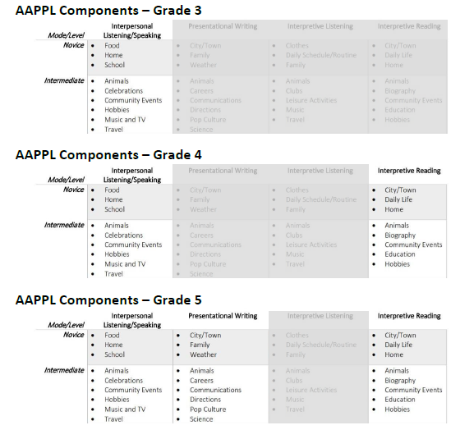
Elementary Grades 3-5 (Parent/ Guardian Proctoring Topics)

Slide 4
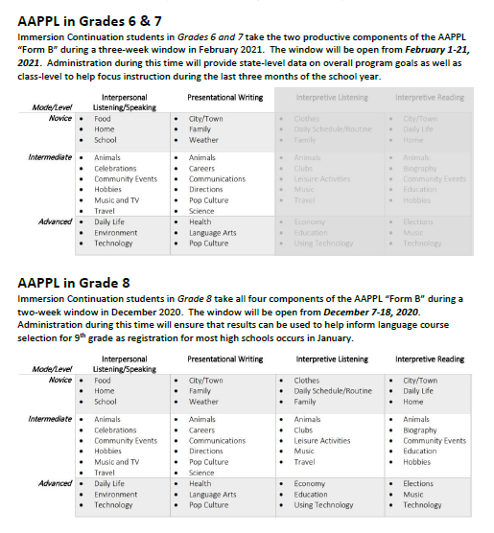
Grades 6-8 (G8 tests occur in December)

Slide 5
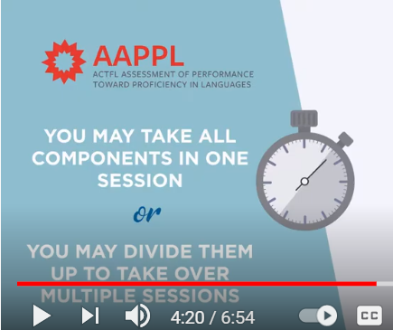
Testing Schedule and Organization
Your school administrator and teaching team have created a testing schedule that will provide the best structure and timing of the tests to ensure the more setting for your students. Students will need headphones with microphones if at school.
Elementary: You will have up to 3 parts, Interpretive L/S (G3-5), Interpretive Reading (G4&5) , & Presentational Writing (G5)
Secondary: You will have up 2 parts (Interpretive L/S, Presentational Writing (G6-7), G8: All sections, including Interpretive Listening also.

Slide 6
Testing Equipment (A)
Students will need a computer, Internet access, and headphones or speakers.
Teachers are leading students to test out their equipment at school and with virtual academy students at home.
--Students will need a microphone for the Interpersonal Listening and Speaking component to record their responses to a virtual video-based chat partner.
Most computers these days already have such features, which means you probably won't need to get any new equipment.

Slide 7
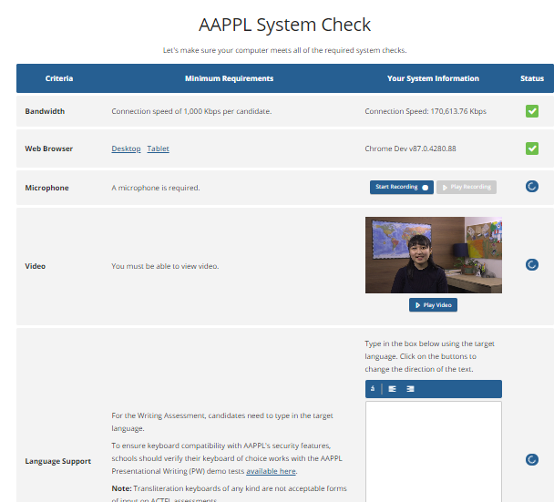
Testing Equipment (B)

Slide 8
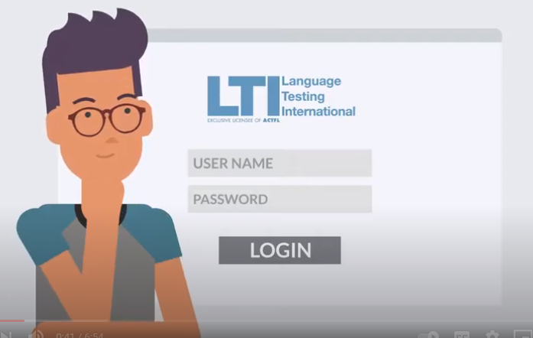
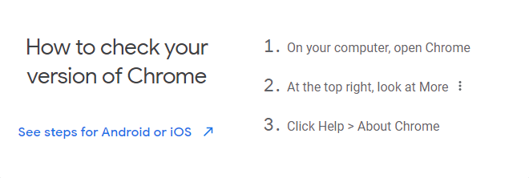
Reminders
Students taking exams from home need to be sure to have downloaded Chrome Version 80 or higher in order for the test to work.
❑ Prepare the secure testing area and have the log-in credentials handy. Remember that test takers must not have access to papers, pens, pencils, notes, dictionaries, cell phones, cameras, or electronic devices while testing.
❑ Log the test taker into the test using the log-in credentials provided by the teacher or school.
❑ Supervise the test taker while completing all components and safeguard their login information between test sessions. Don’t help them to answer any questions on the AAPPL.
Destroy/delete test taker login information once testing is complete for all components.
Please remind students to do their best, say and write as much as they can. Let them know it’s a way to show all that they know.

Slide 9
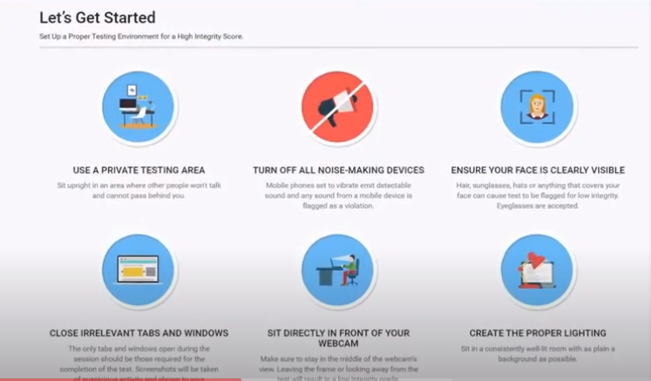
Testing Environment

Slide 10
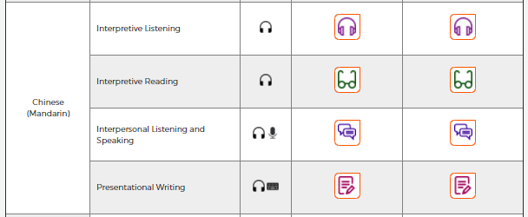
Language Demo
Teachers have been conducting in-language testing so that students could practice the following components:
Interpersonal Speaking/Listening: (30-40 minutes) (3rd-8th grades)
Interpretive Reading (4th,5th,8th)
Presentational Writing (5th, 6th, 7th, 8th)
AAPPL 2.0 Demos | Language Testing International

Slide 11
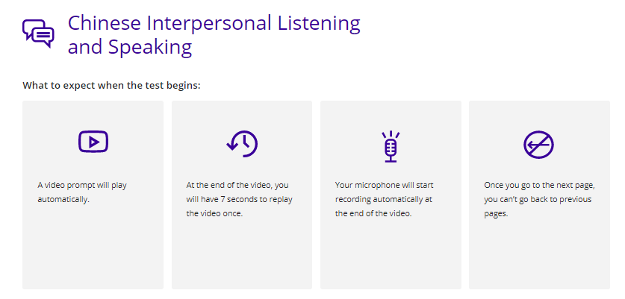
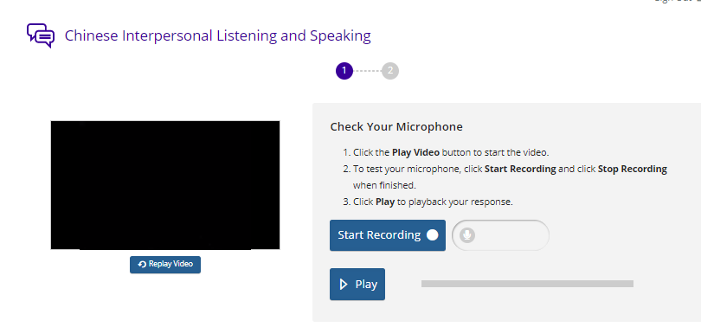
Language Tasks Listening/ Speaking

Slide 12
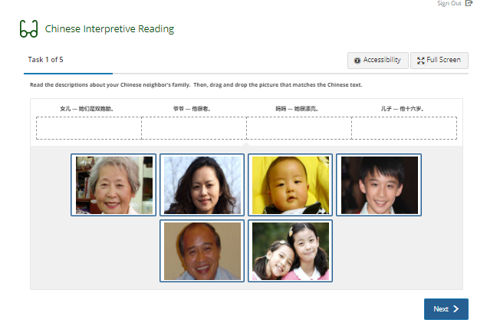
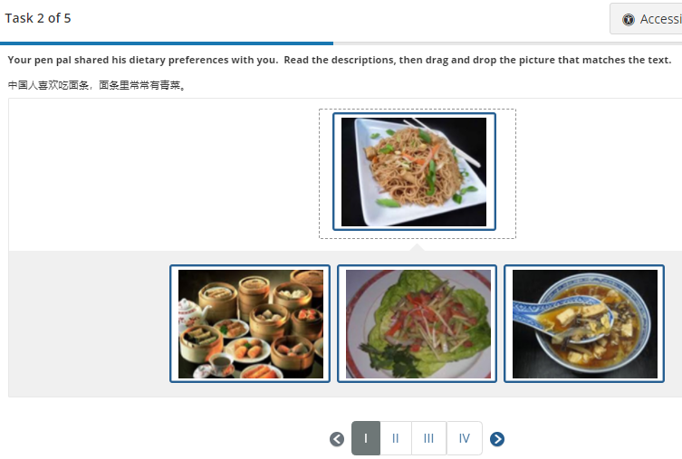
Language Tasks Reading (4 tasks)

Slide 13
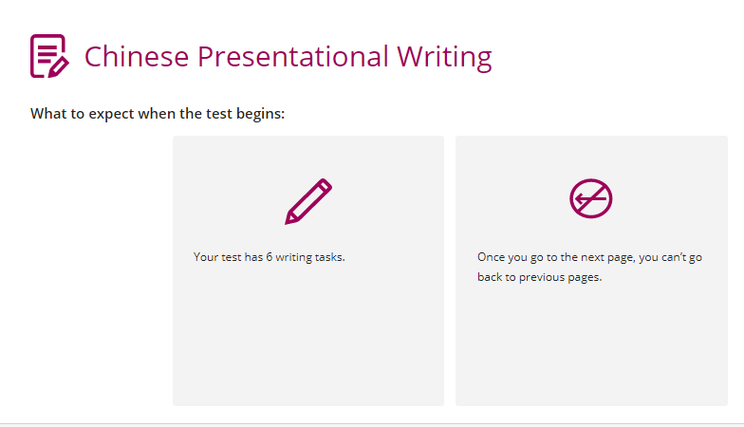
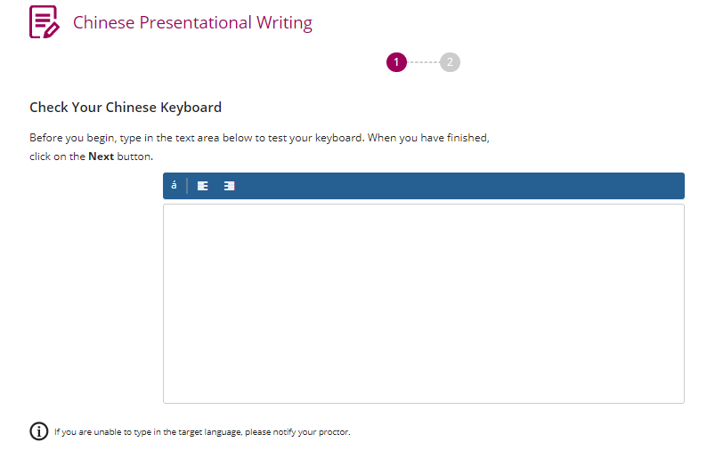
Language Tasks Writing

Slide 14
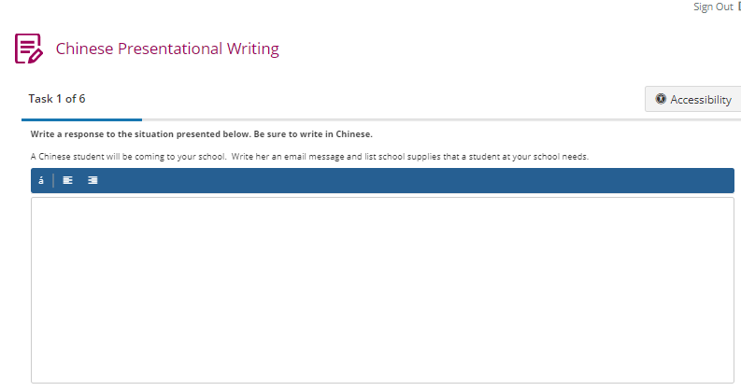
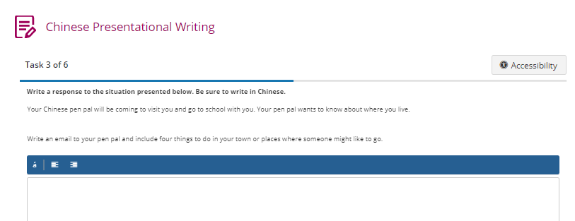
Language Tasks Writing

Slide 15
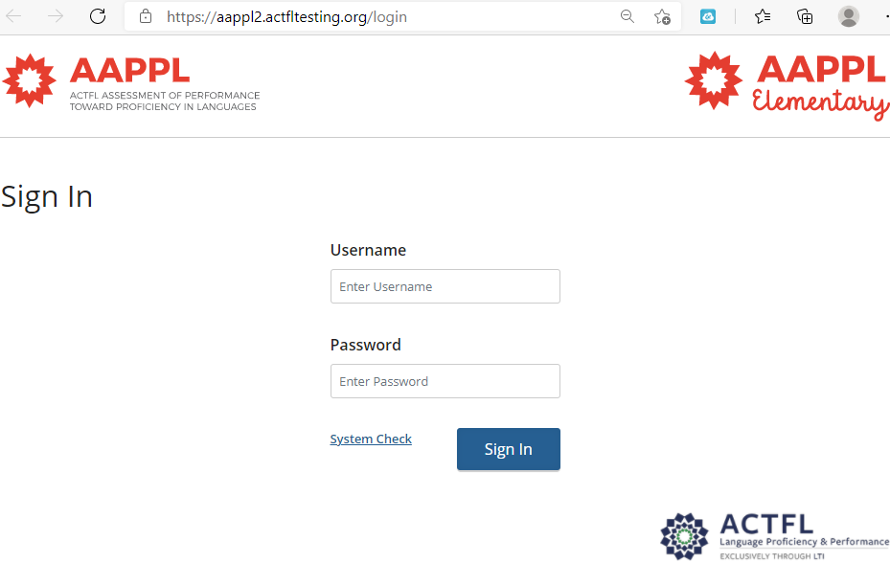
AAPPL Sign-In & test labels
Are there security features for the AAPPL?
Yes. The AAPPL has several test-security features. First, test takers must take an honor pledge at the beginning of each AAPPL mode. Second, they will be logged out of the test automatically if they navigate away from the test and open another program, browser window, or tab.
Other features that are automatically disabled include:
For Customer Support queries, please email aapplhelp@languagetesting.com or call LTI during the hours listed on page 2. Last edited 3/27/2020 4:23 PM 2
» the right-click feature of the mouse,
» the browser back button,
» the Copy, Paste, and Cut keyboard shortcuts (Ctrl + c, Ctrl + v, and Ctrl + x),
» the Google Translate browser extension, if installed.

Slide 16
Q&A?

