Slide 1
Chinese Immersion @ Shue Medill MS
& Christina’s K-12
Dual Language Immersion

Slide 2
AGENDA
K-12 DLI Pathway
Chinese DLI Program
Shue MS DLI Introduction
Shue DLI Teachers Ms. Li and Ms. Wang & Overview
School Tour

Slide 3
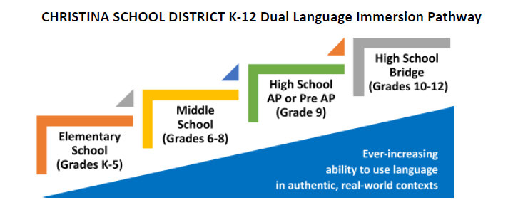
Christina K-12 DLI Pathway
Notes:
Norm

Slide 4
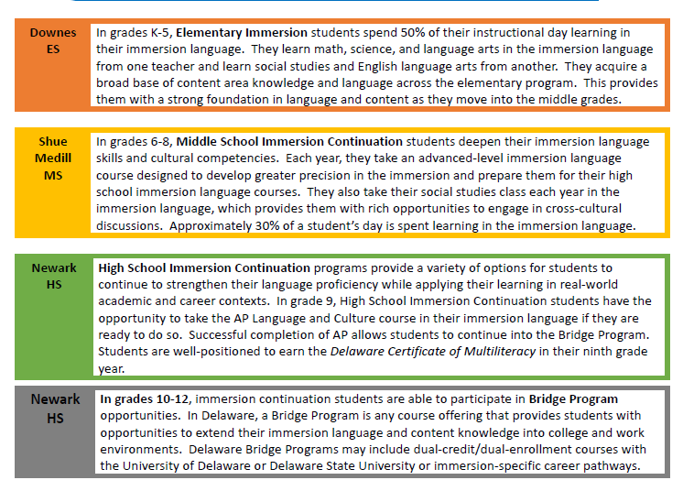
Christina K-12 DLI Pathway
Notes:
Norm

Slide 5
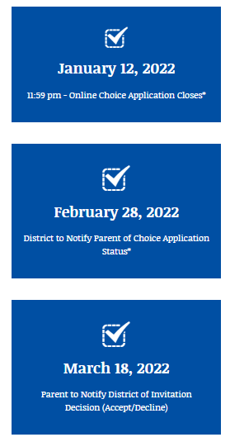
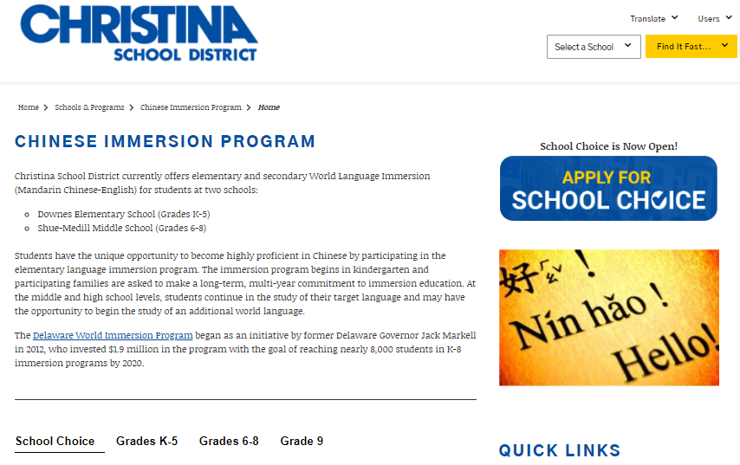
Reminder: School Choice Applications Due

Slide 6
Christina 6-12 DLI Pathway
Notes:
Helen

Slide 7
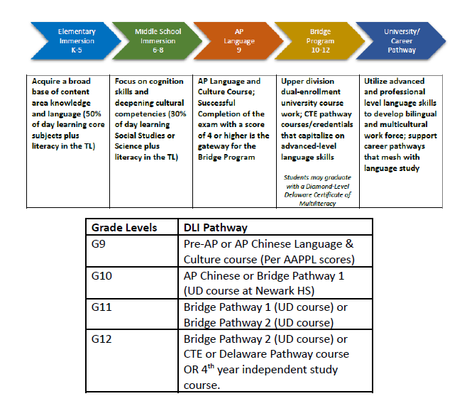
Christina G9-12 DLI Pathway
Notes:
Helen

Slide 9
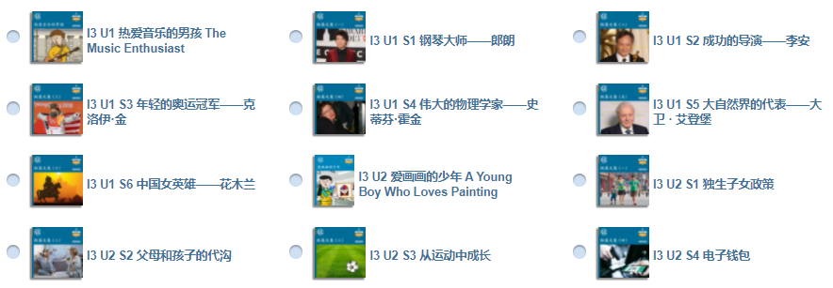
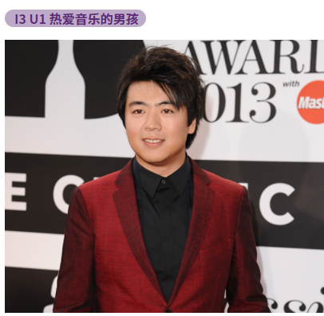
Chinese Immersion Curriculum
Grade 6 Chinese Literacy:
Mandarin Matrix:
CCSS/CLA standards, goal to develop fluent, independent readers.
Stresses language through stories.
Offers largely fictional texts ranging in topics in everyday life, ranging from travel, SEL, relating to others, science experiments, to Chinese culture.
Can turn on pinyin, read aloud features.

Slide 10
MS: Preparing our students to be Globally Competent:

Slide 16
Chinese Immersion Curriculum
Grade 8 Global Captstone Project:
· Connect to AP Themes and iChinese Unit topics
· Implement a year-long portfolio approach to collect evidence
· Provide students with voice and choice
· Use the Asia Society Global Competency rubric
· Present in person or online to an authentic audience

Slide 17
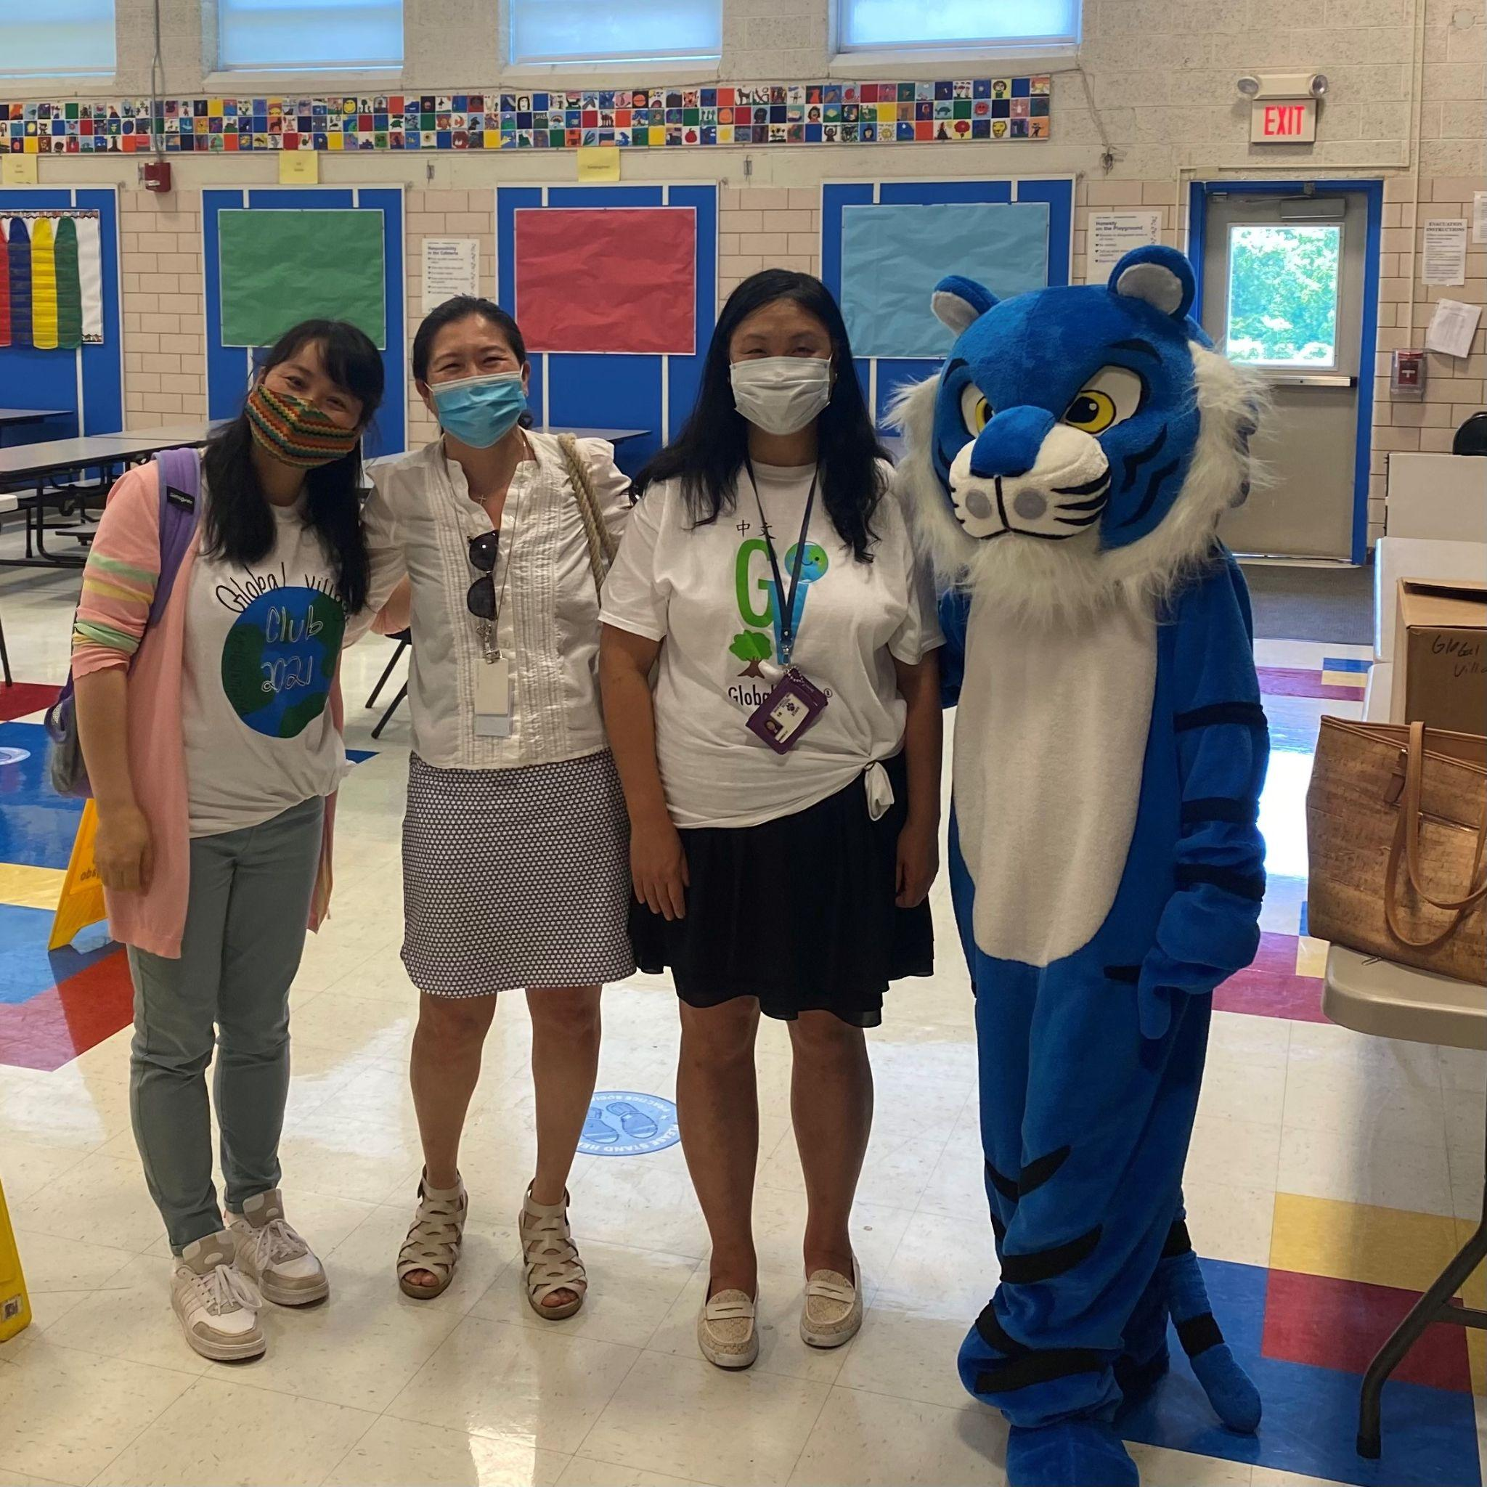
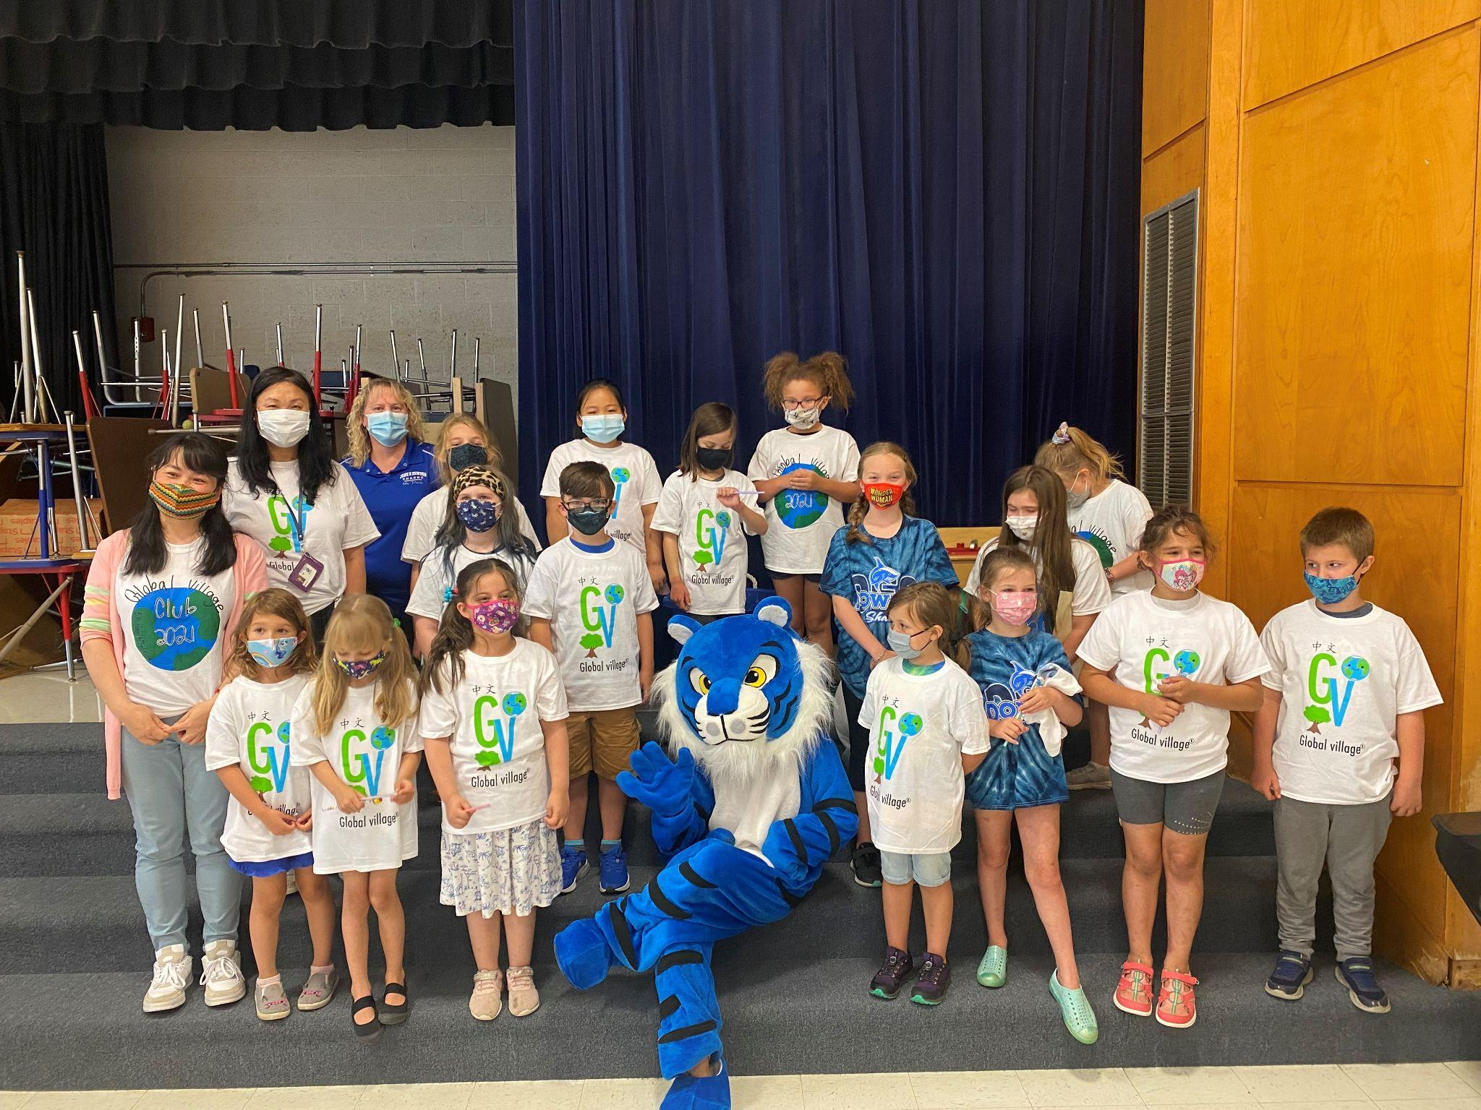
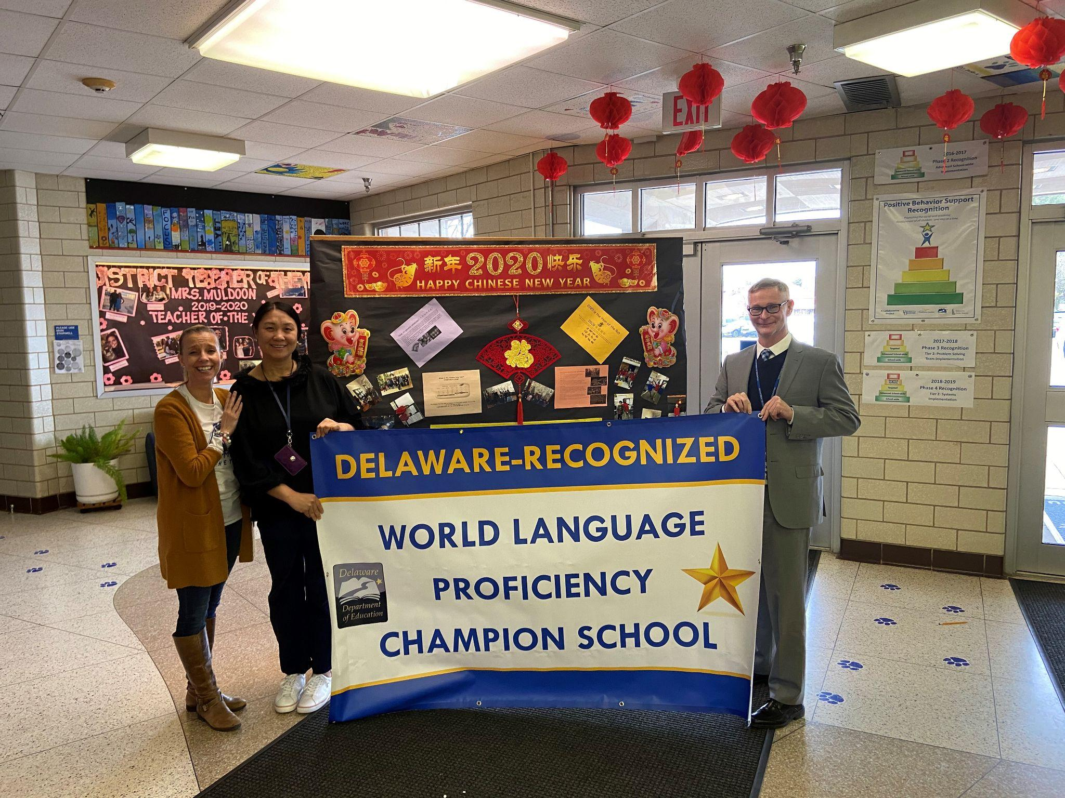
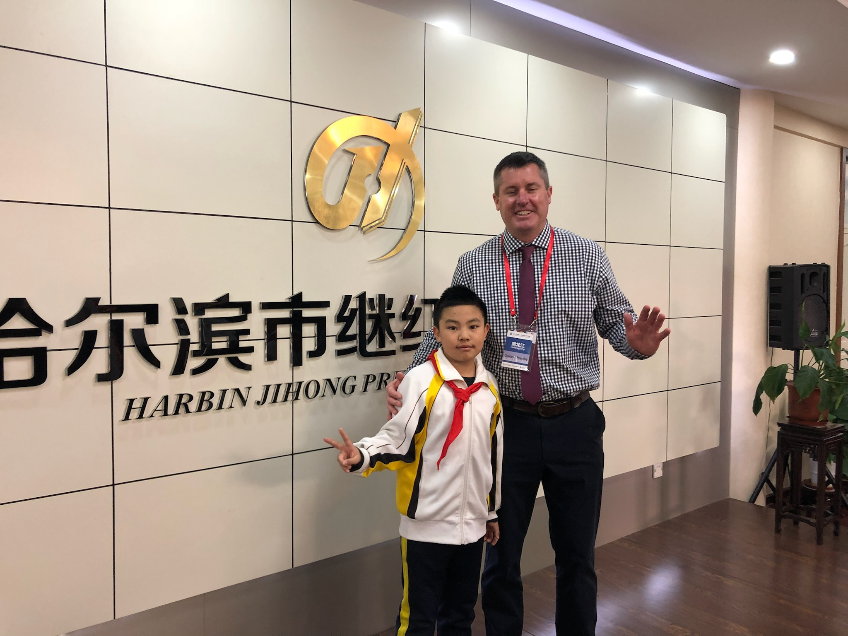
Shue Medill MS & Introduction
Ms. Michele Savage - Principal
michele.savage@christina.k12.de.us
Mr. Chuck Priestley - Assistant Principal
charles.priestley@christina.k12.de.us
Ms. Andrea Li - Immersion Teacher
zhaochun.li@christina.k12.de.us
Ms. Eileen Wang - Immersion Teacher
liping.wang@christina.k12.de.us

Slide 18
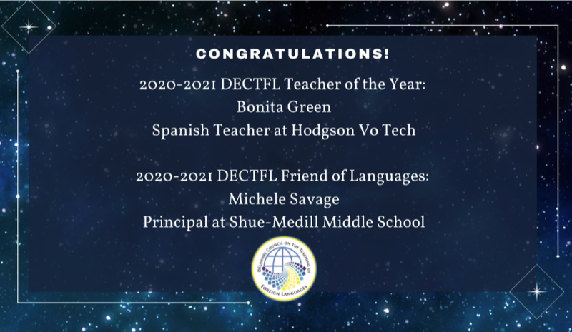
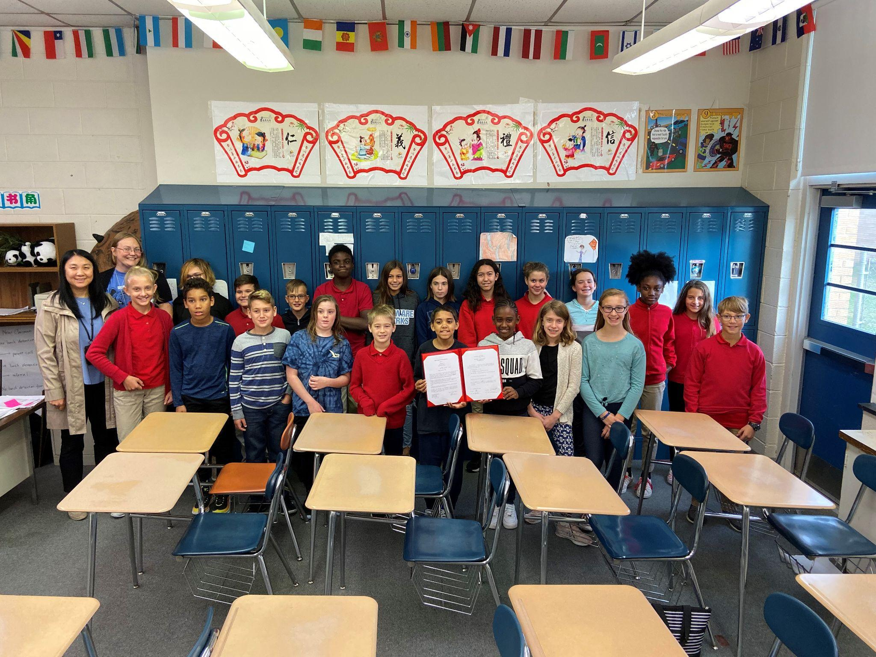
Shue Medill MS & Introduction
Timeline of Events
Spring 2014 Chinese Language taught through Middlebury
2014 -2015 Continuation of Middlebury Program
2015-2016 - Middle School Immersion Advisory Committee
Attend FLAN Conference in Utah
Meet with Downes and review program
2016 - 2017 Partnership with Confucius Institute at University of DE
2017-2018 Participate in Middle School Immersion Continuation
Superintendent Study Mission in Alaska
Identify teacher for 2018/2019 school year Chinese Lang/Soc
Visit Downes students, check in with Downes and
present to parents.
Attend Immersion Principal Institute in June.
2018 -2019 Ms. Li co-teaches Social Studies and observes Downes
classes to prepare for the next school year.
2019-2020 Welcome our first 6th grade Immersion class
2020-2021 Welcome our 2nd 6th grade Immersion class
Begin Global Village connection with Downes
2021 - 2022 Welcome our 3rd 6th grade Immersion class and graduate
our first 8th grade class!!!

Slide 19
Chinese Class/Enrichment 中文课
➤ Mandarin Matrix DLI Inter3; iChinese Book 2 & Book 4
➤Task based with emphases on:
∎ Speaking on a variety of topics
∎ Expressing feeling & opinions
∎ Recognizing Chinese characters
∎ Improving reading literacy
∎ Learning in a cultural context
➤ Website Resources
iChineseReader/Quizlet/Quizizz/Flipgrid

Slide 20
Social Studies Class 社会科学
➤ Delaware Recommended Social Studies Curriculum
➤Additional Resources
Discovering World Geography (McGraw Hill Education)
Discovering Our Past: A History of the United States (McGraw Hill Education)
Stanford History Eudcation Group
Gilder-Lehrman Institute
Junior Scholastic Magazine
CNN 10
Common Lit
iCivics
Nearpod
Online tools like seterra.com, CIA World Factbook, etc.

Slide 21
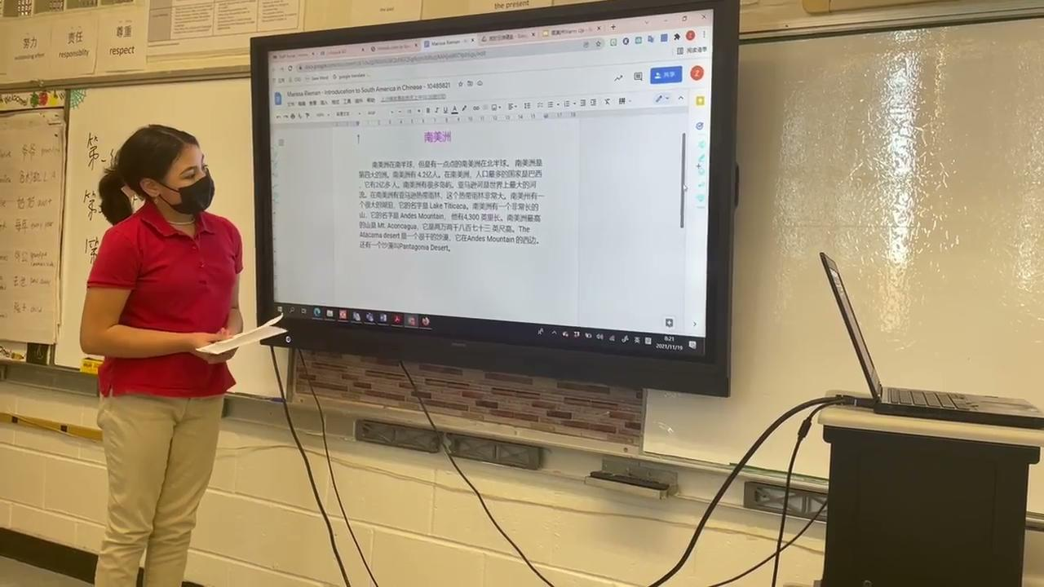

Slide 22
Project-Based Learning:
Chinese biography book study project:
https://drive.google.com/drive/folders/1fdPxHva0fdGFXkQcEamY5ADkiUgHd3Rz?usp=sharing

Slide 23
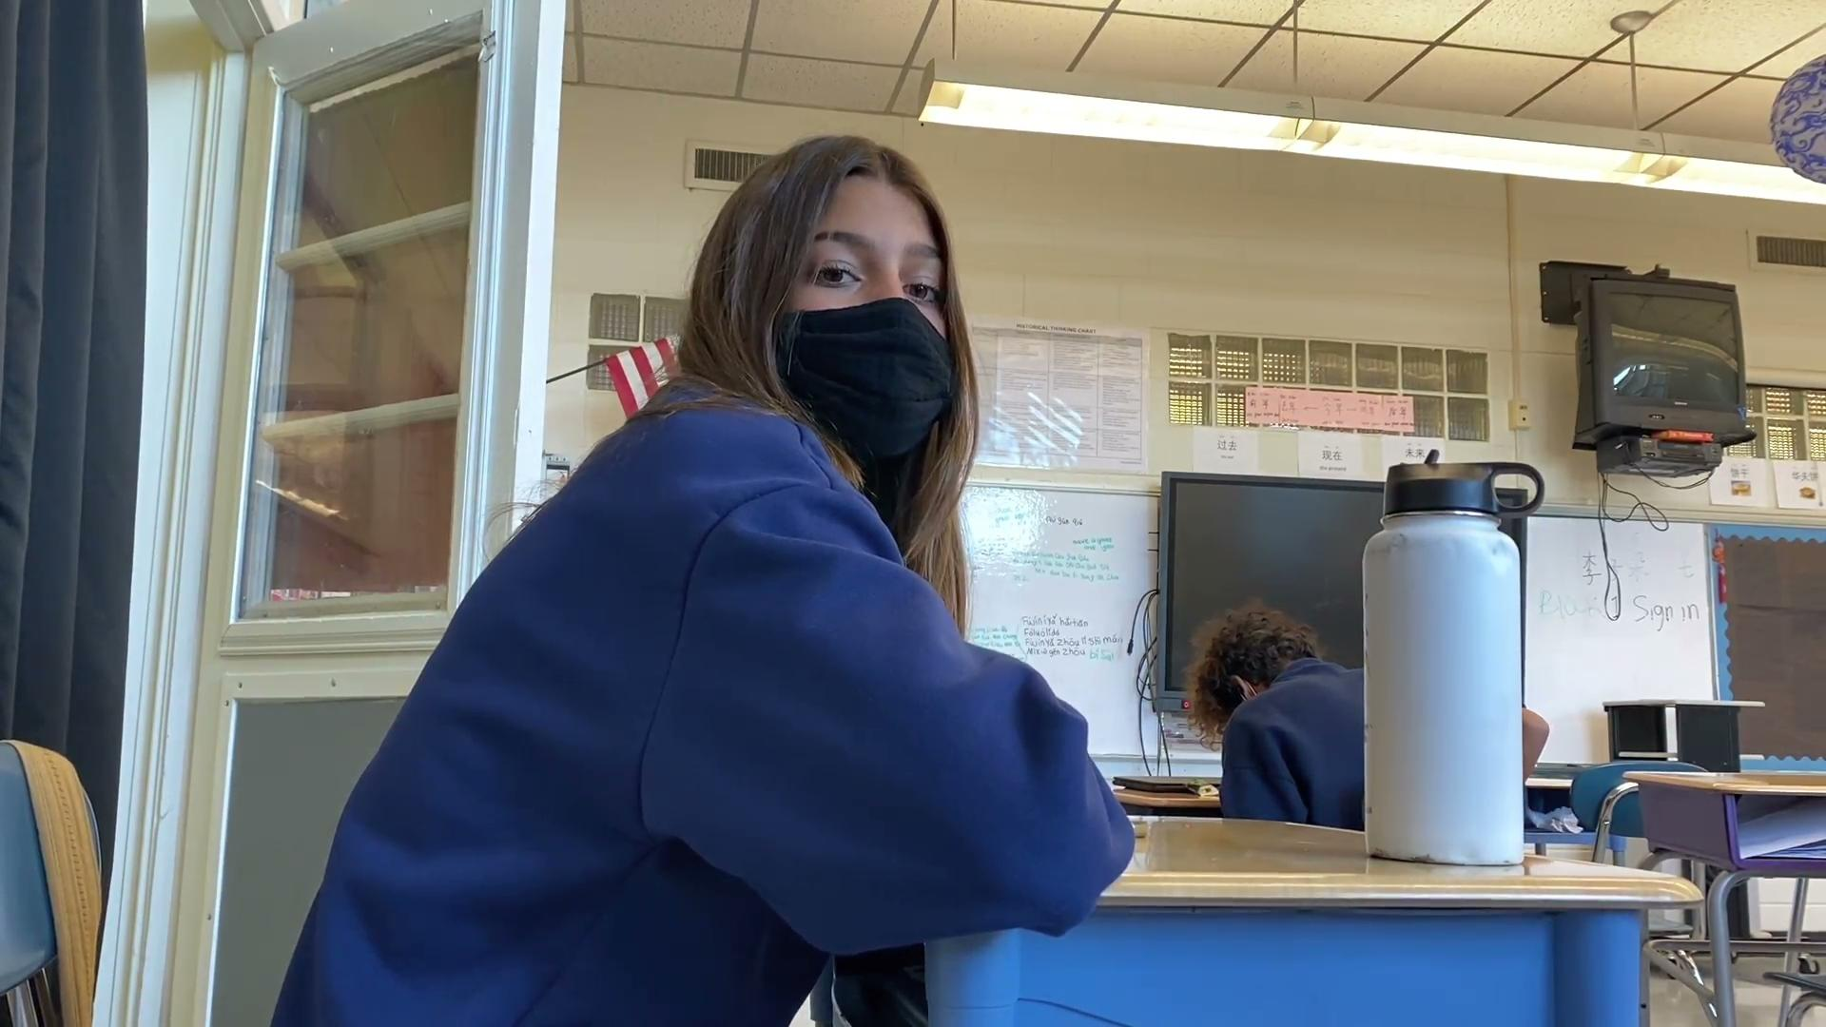
Chinese Video-Making Contest:
https://drive.google.com/drive/folders/152pNBrgO7PxJ6EveZ9eoCJjV2ekZgS7u?usp=sharing

Slide 24
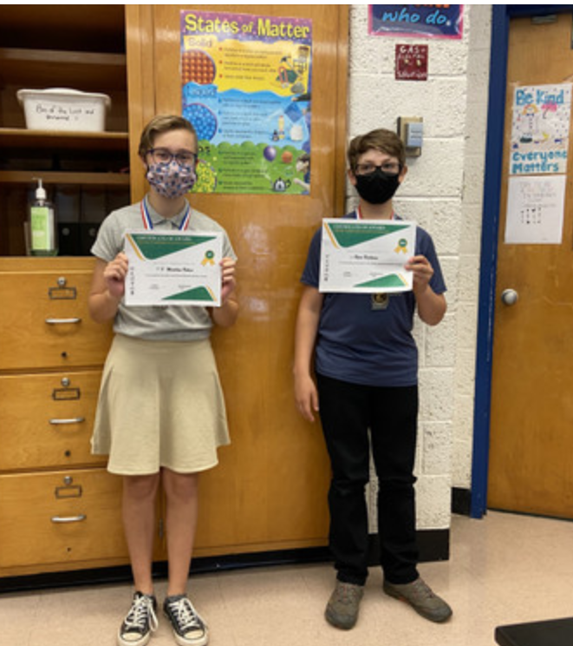
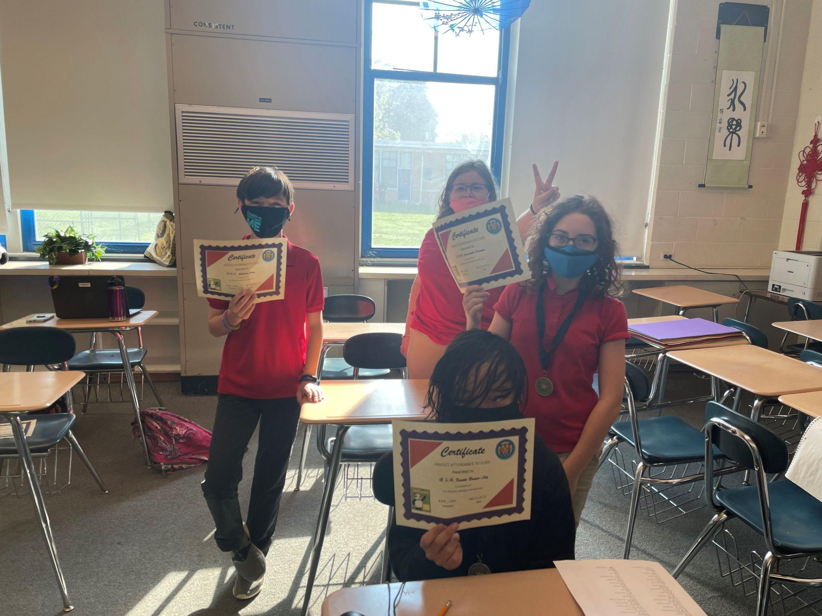
Chinese Words Recognition Contest:

Slide 25
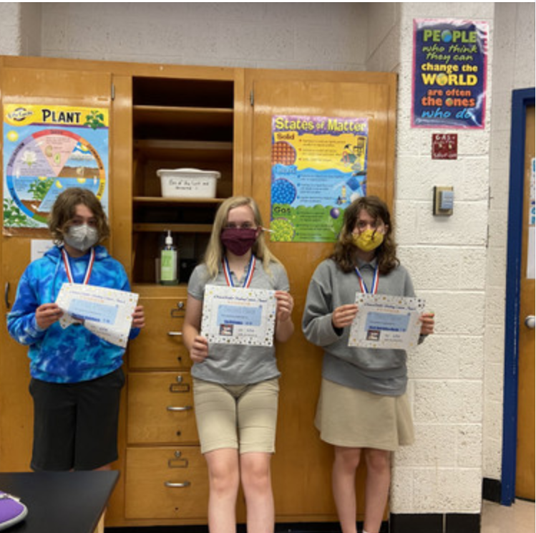
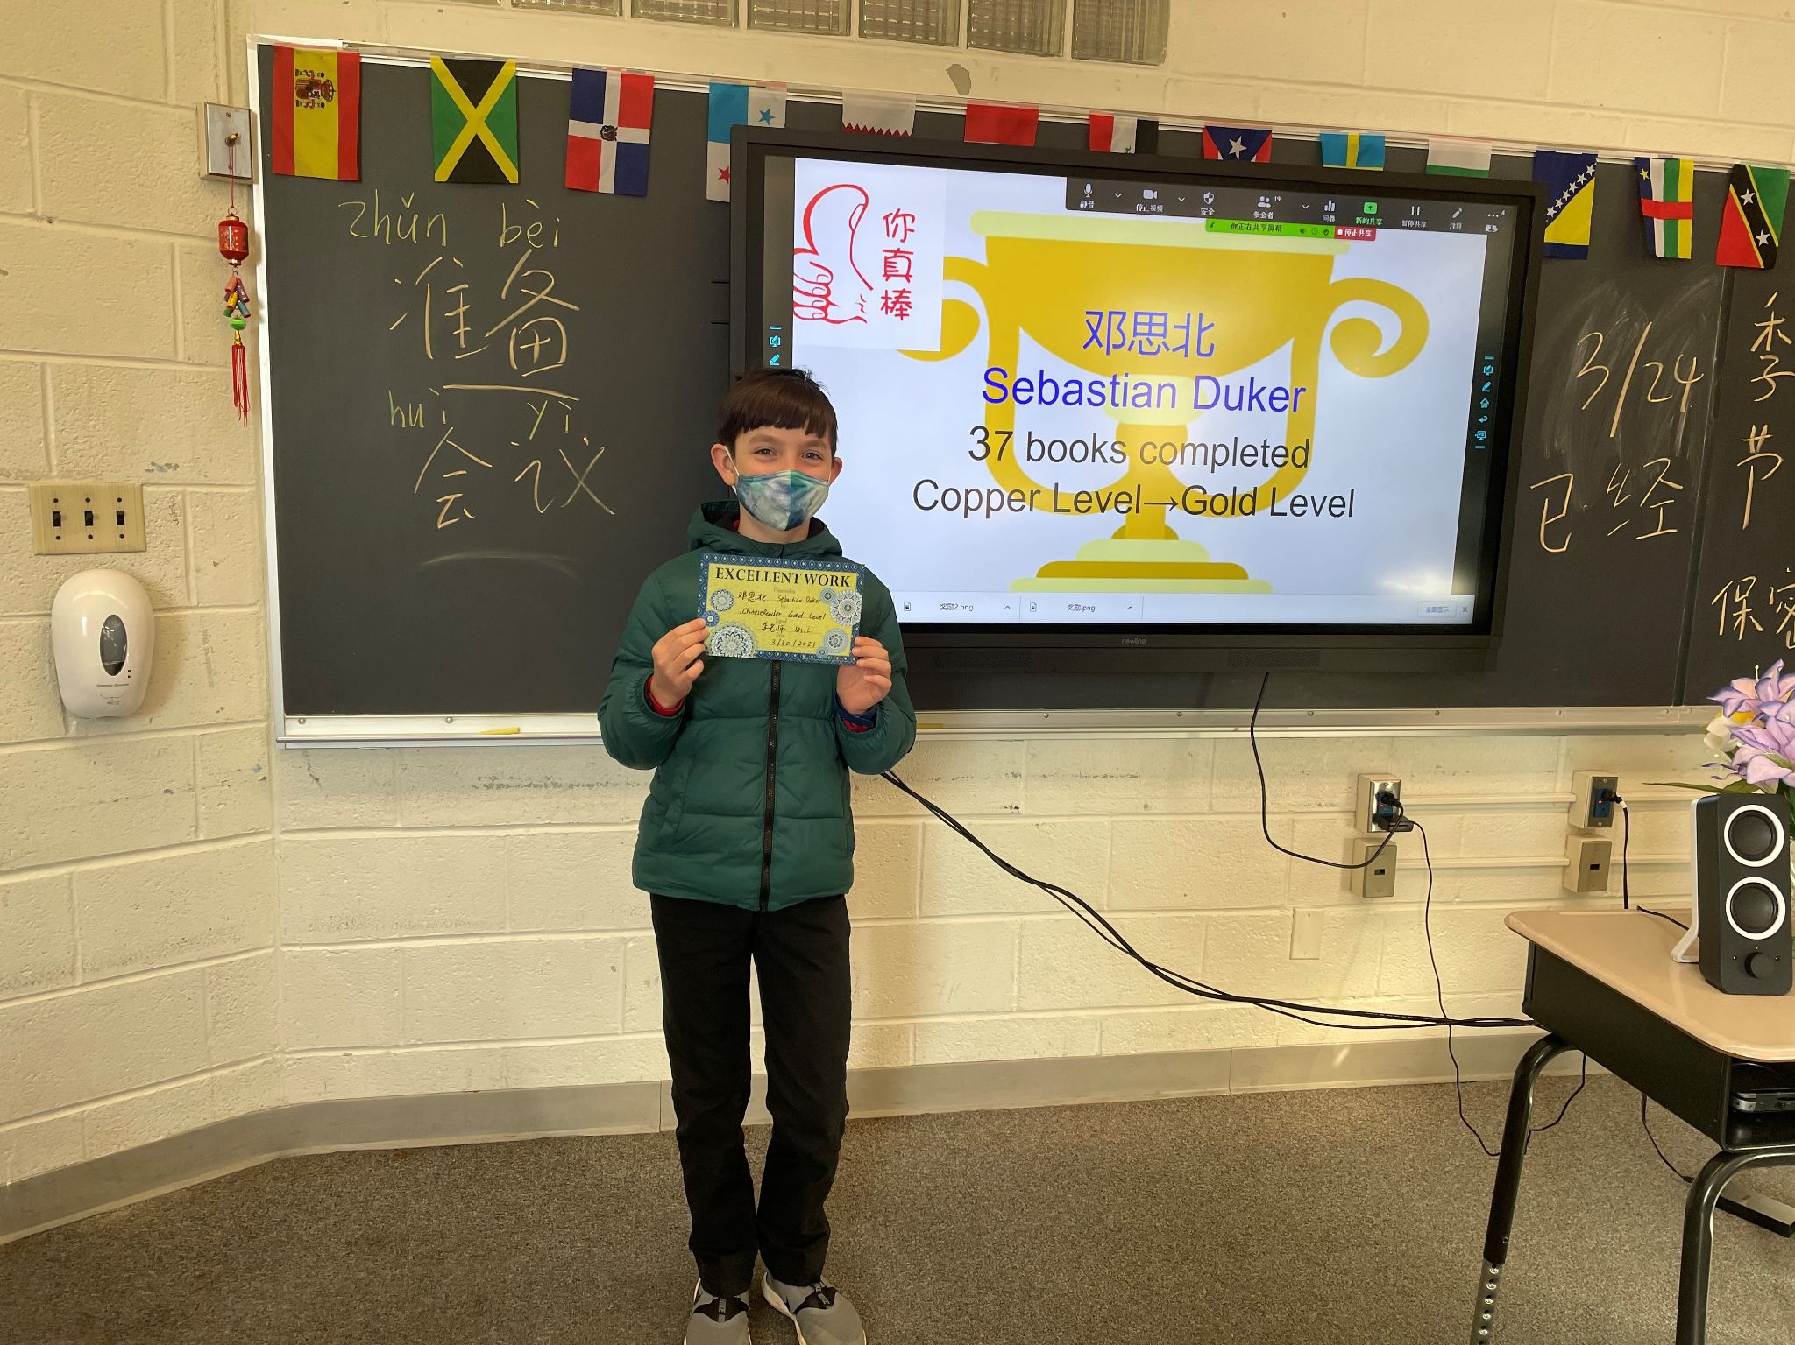
iChinese Reader Reading Contest:

Slide 26
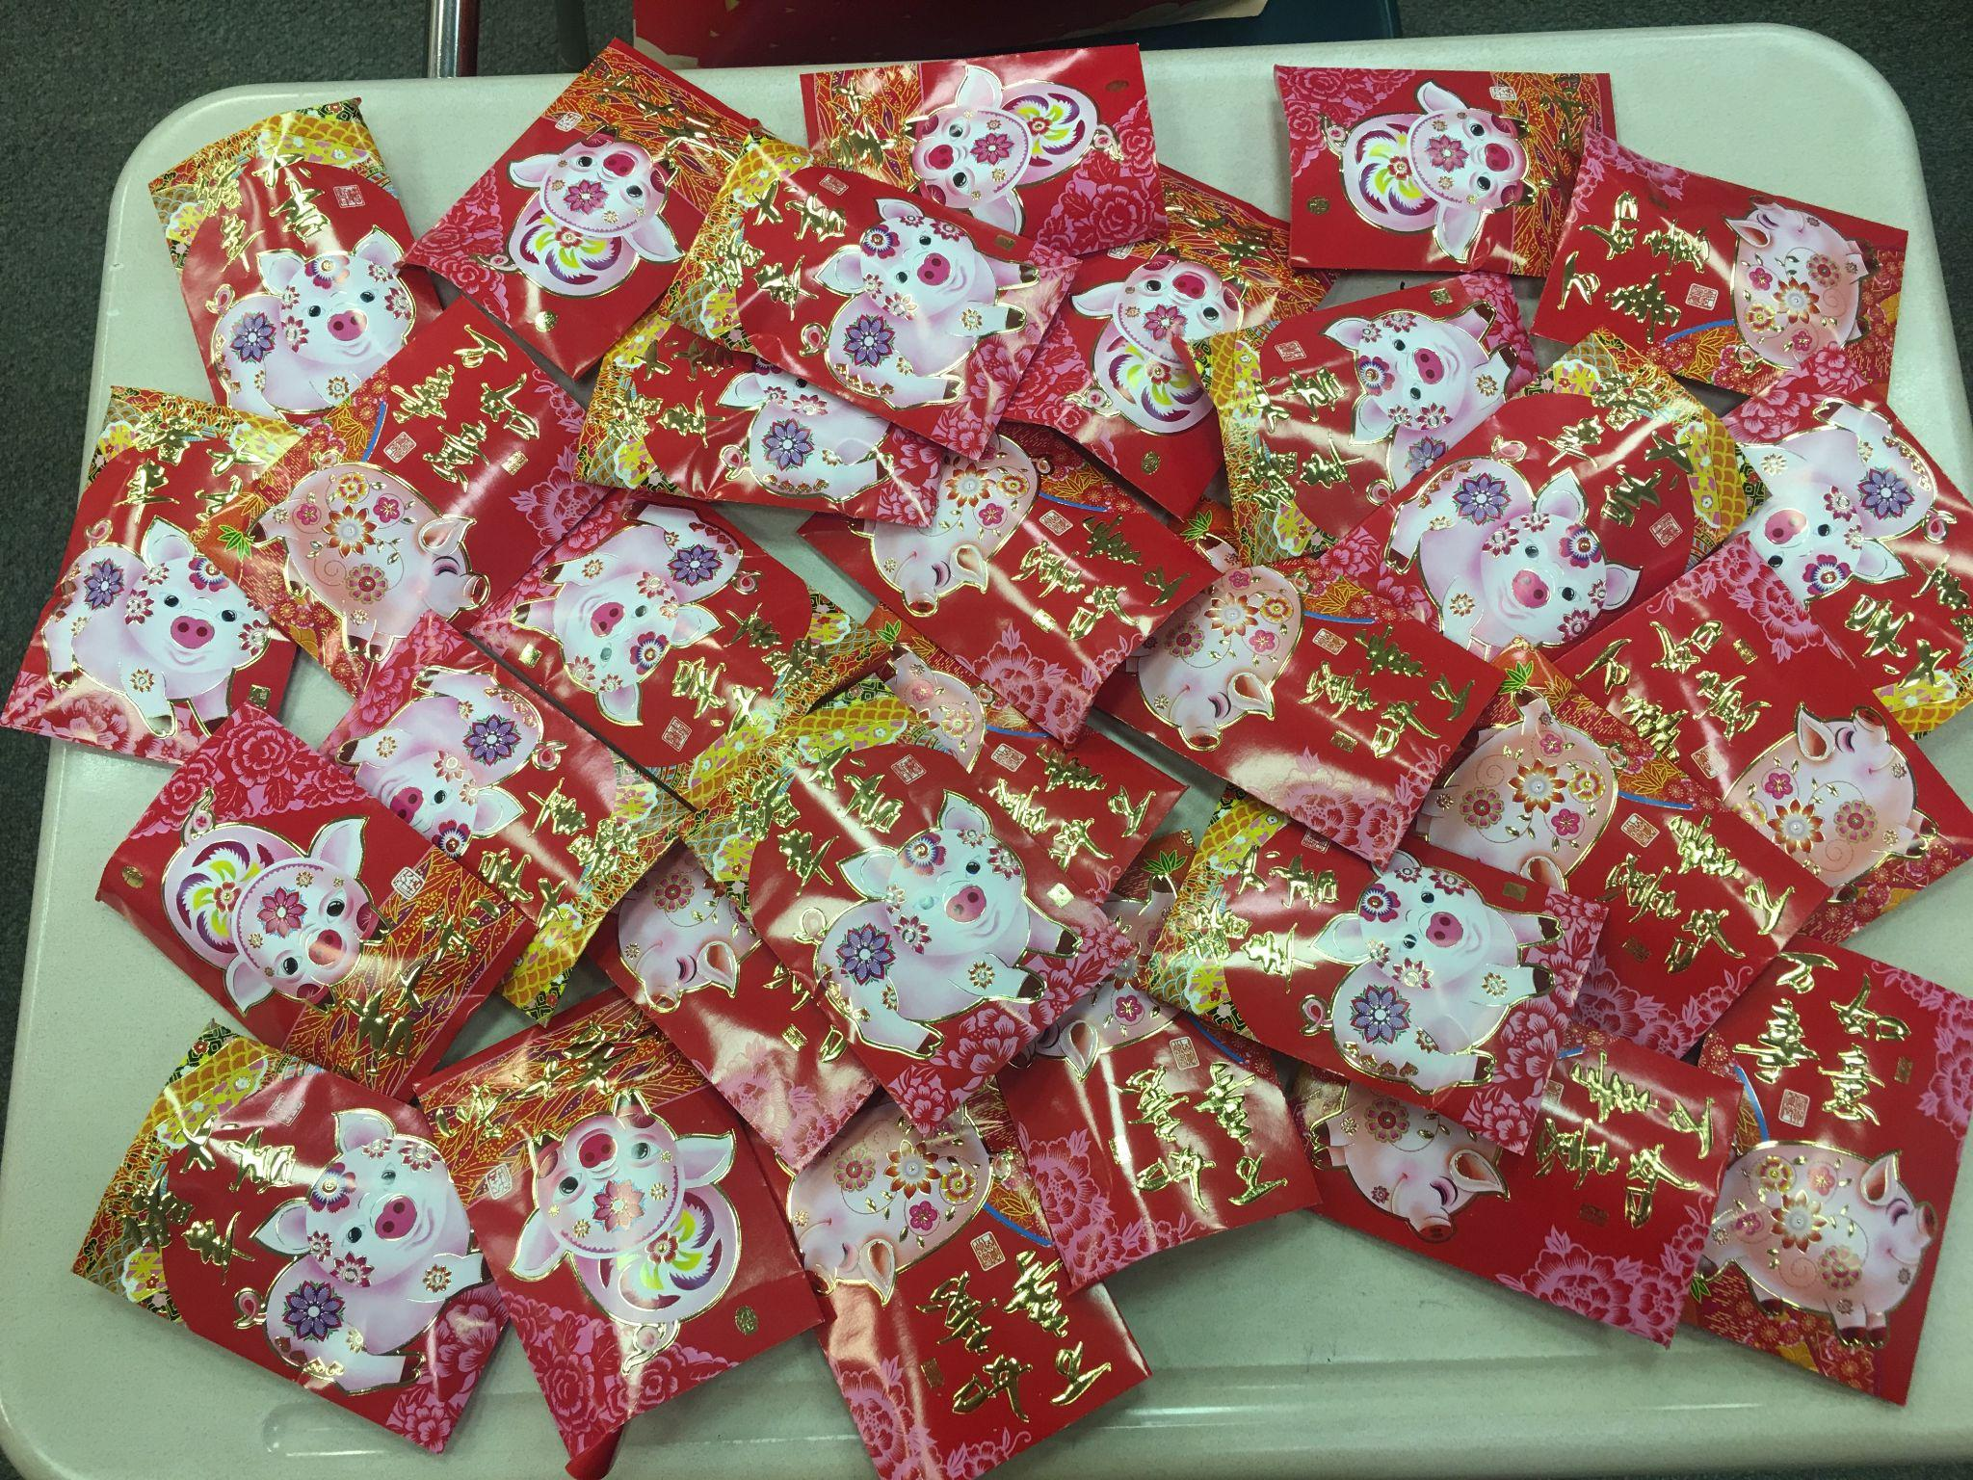
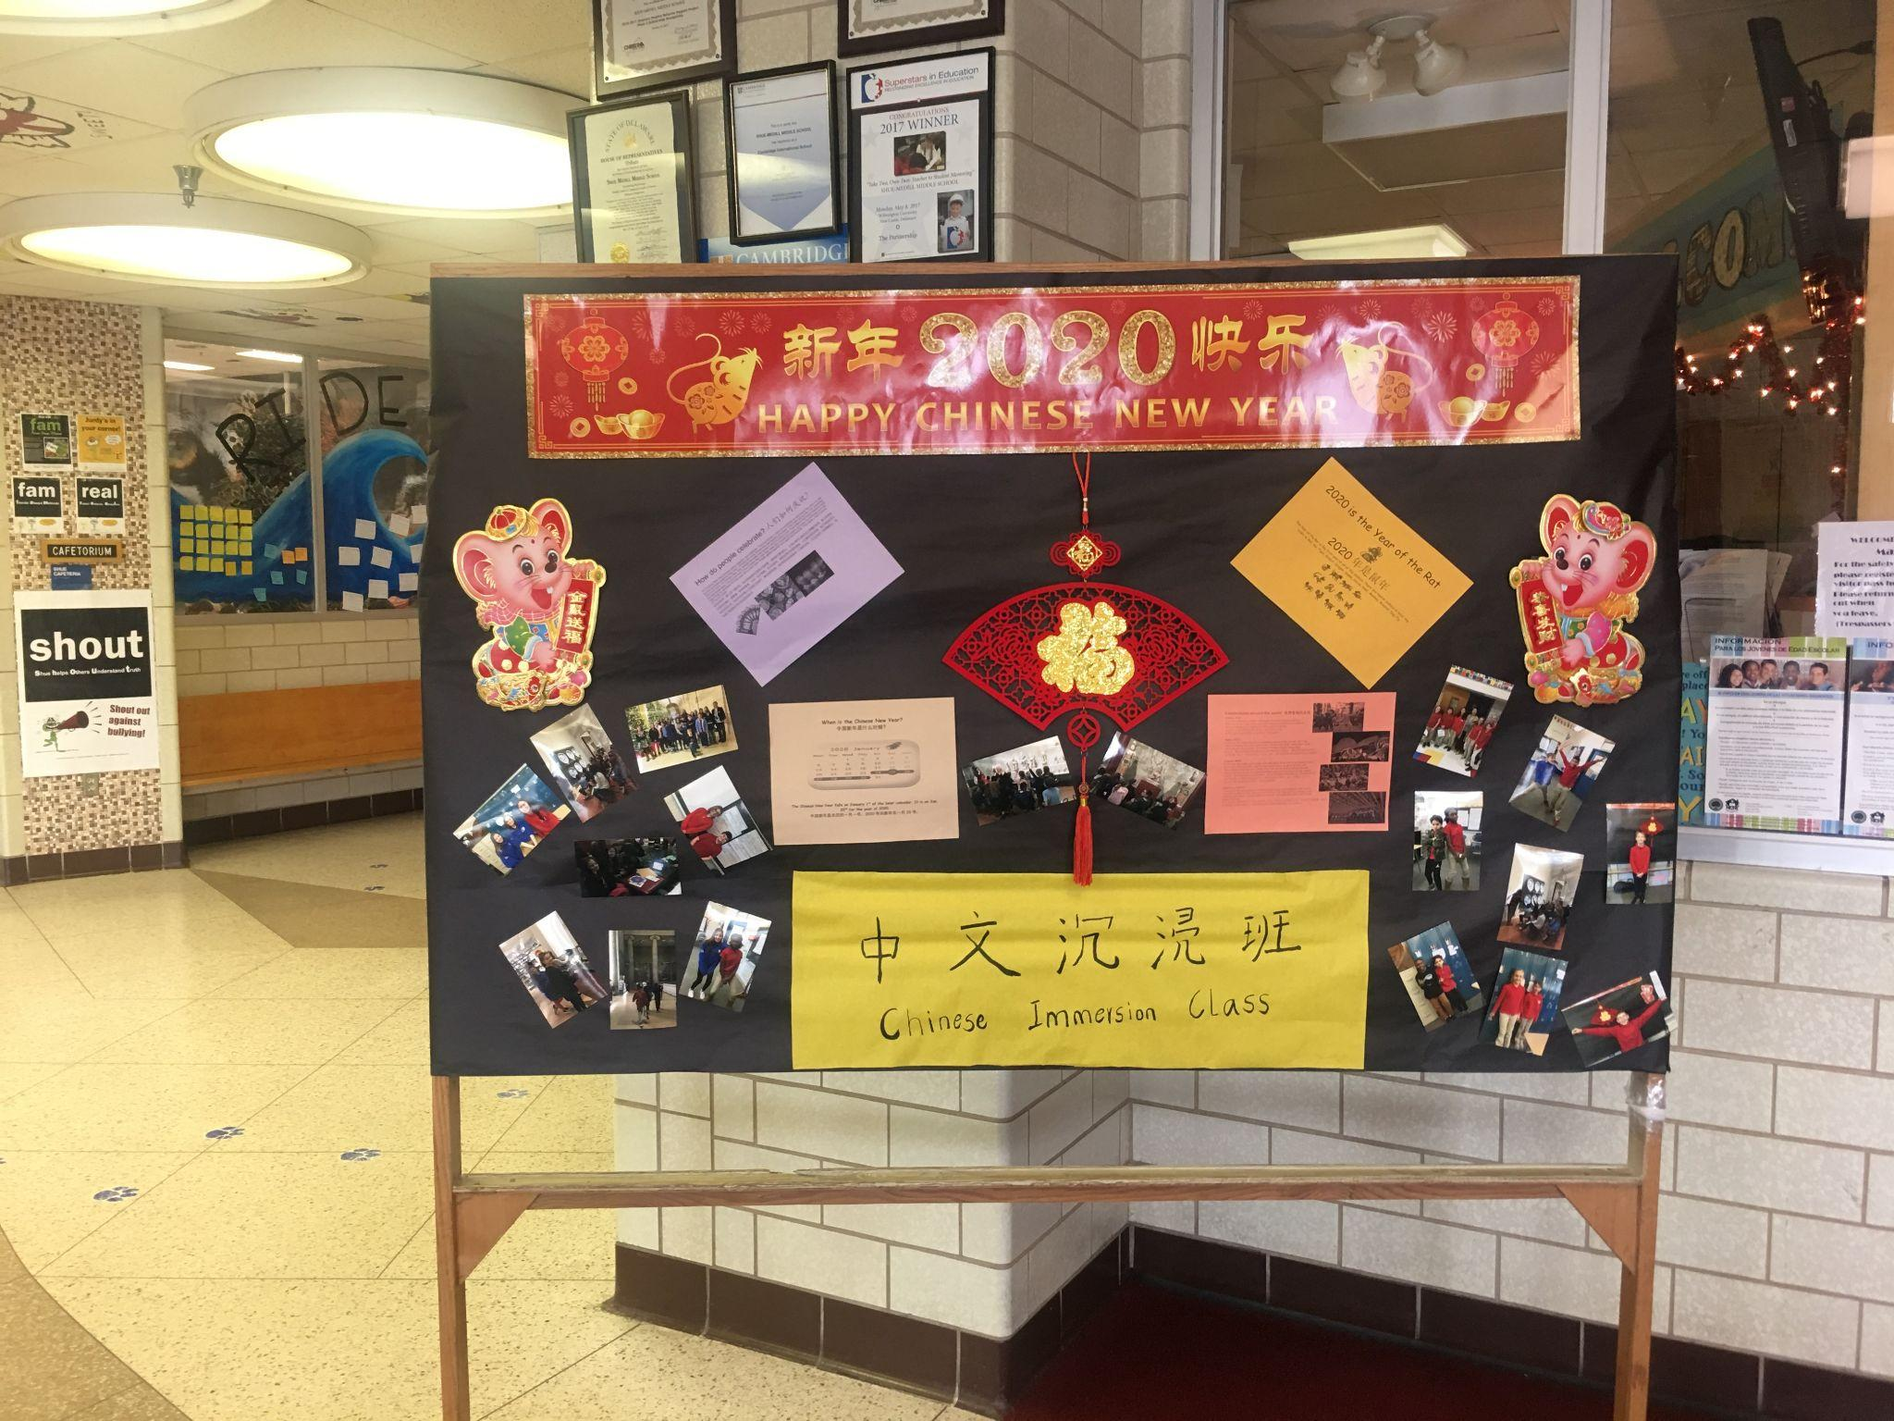
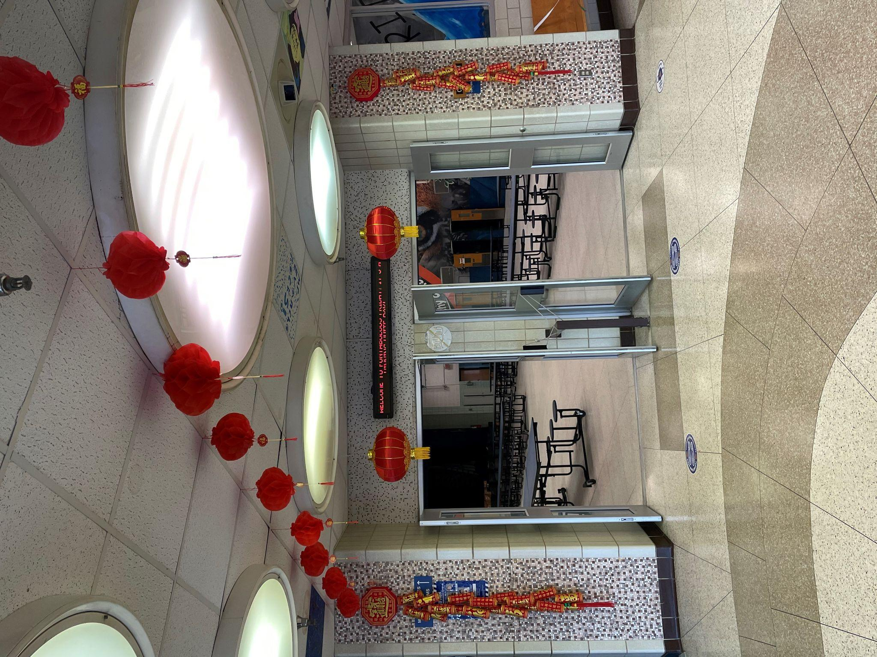
Chinese New Year Celebration:

Slide 27
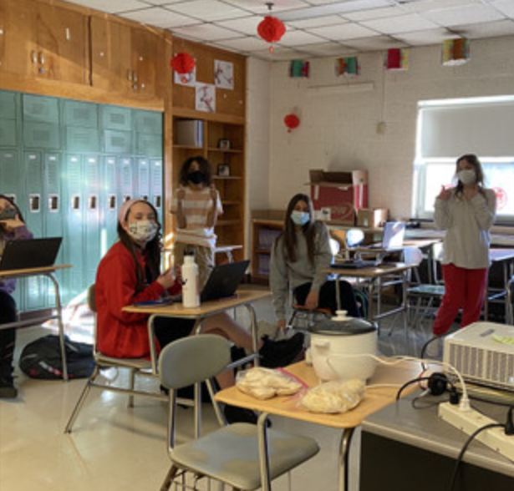
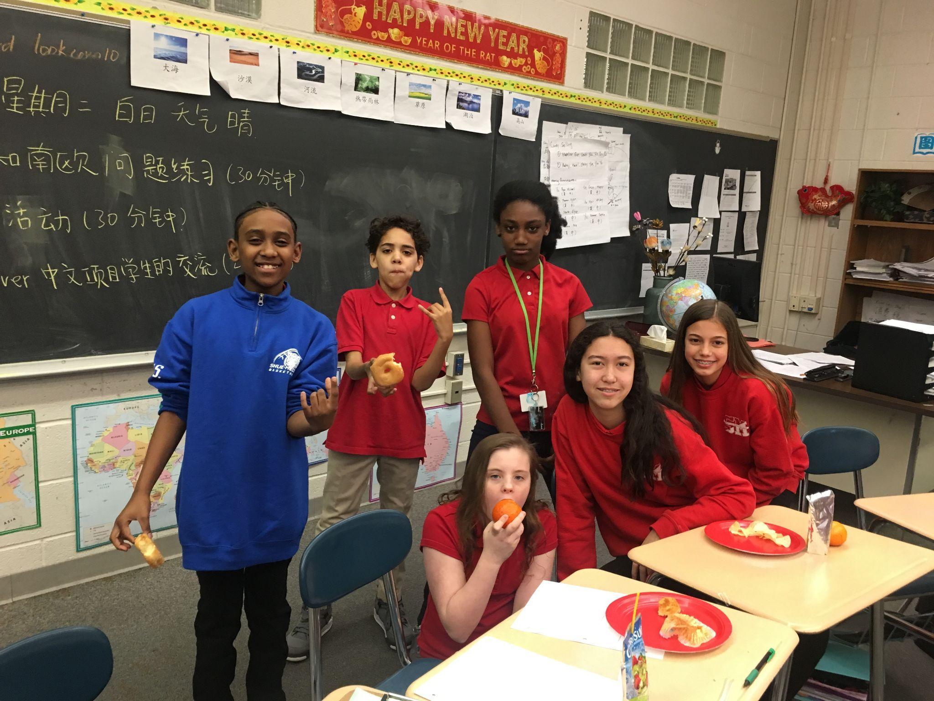
Chinese New Year Celebration:

Slide 28
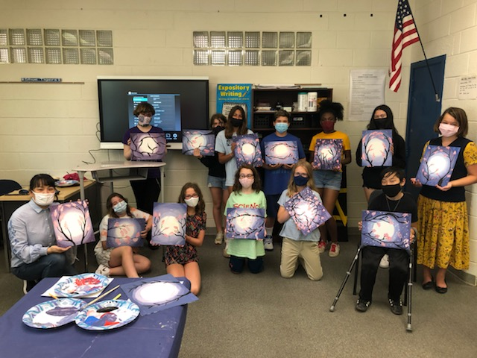
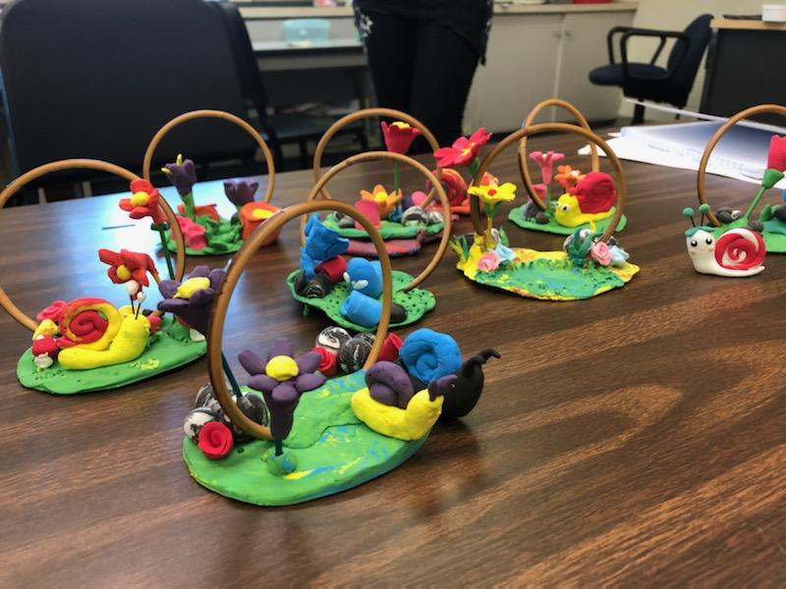
Summer Immersion Program (2021):

Slide 29
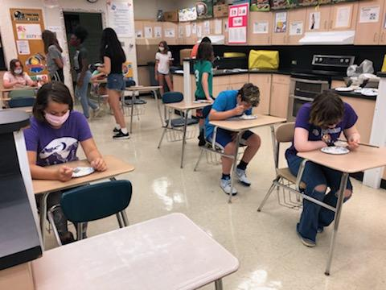
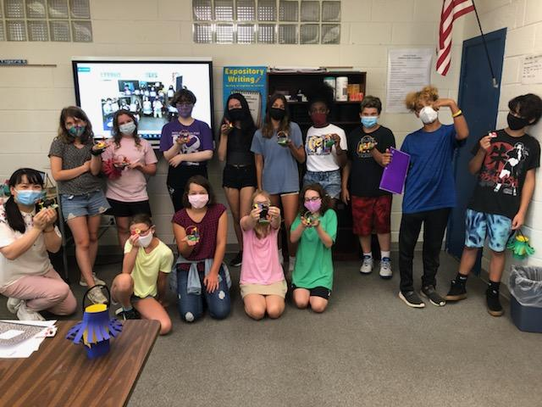
Summer Immersion Program (2021):
https://drive.google.com/drive/folders/1iLPQT2jdwPnKbKOyEkfdnF4kcd1RBa9A?usp=sharing

Slide 30
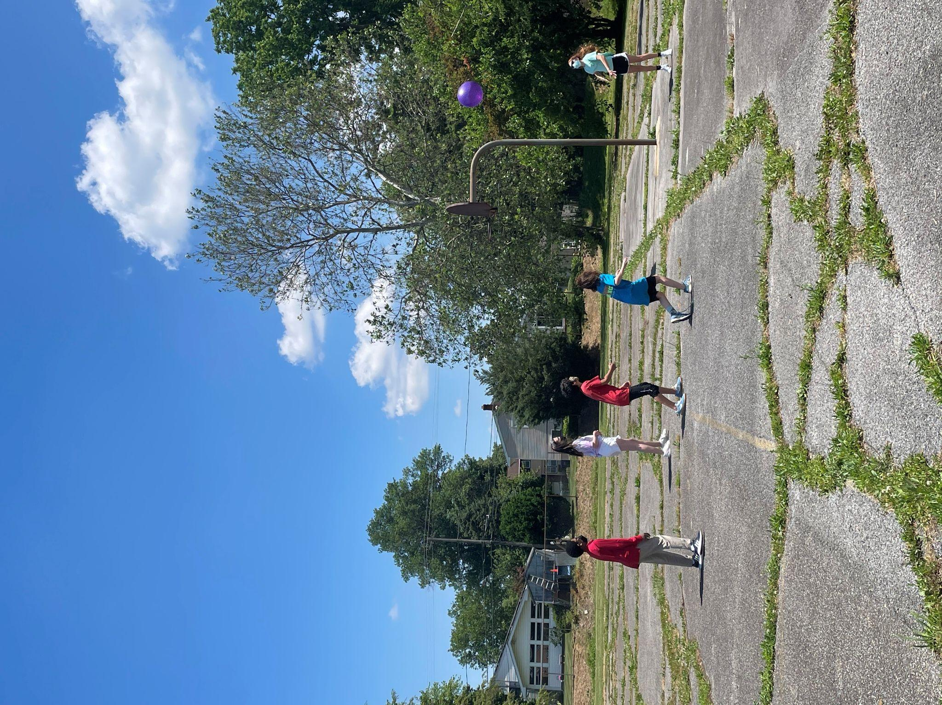
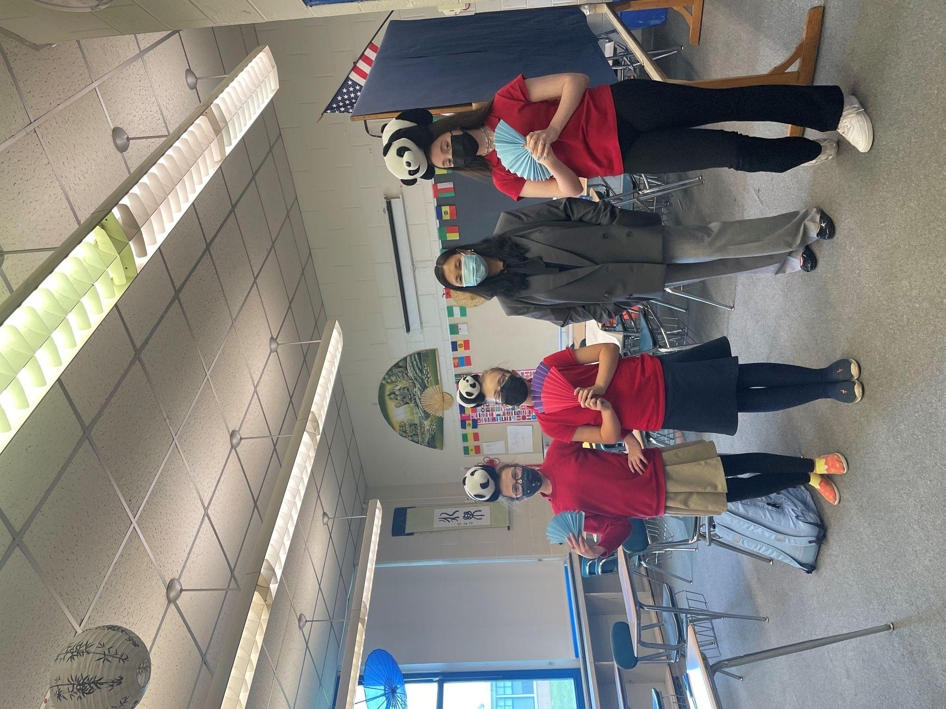
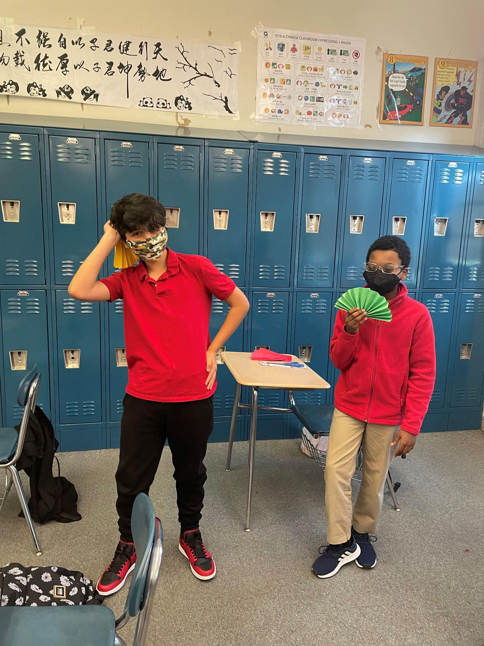
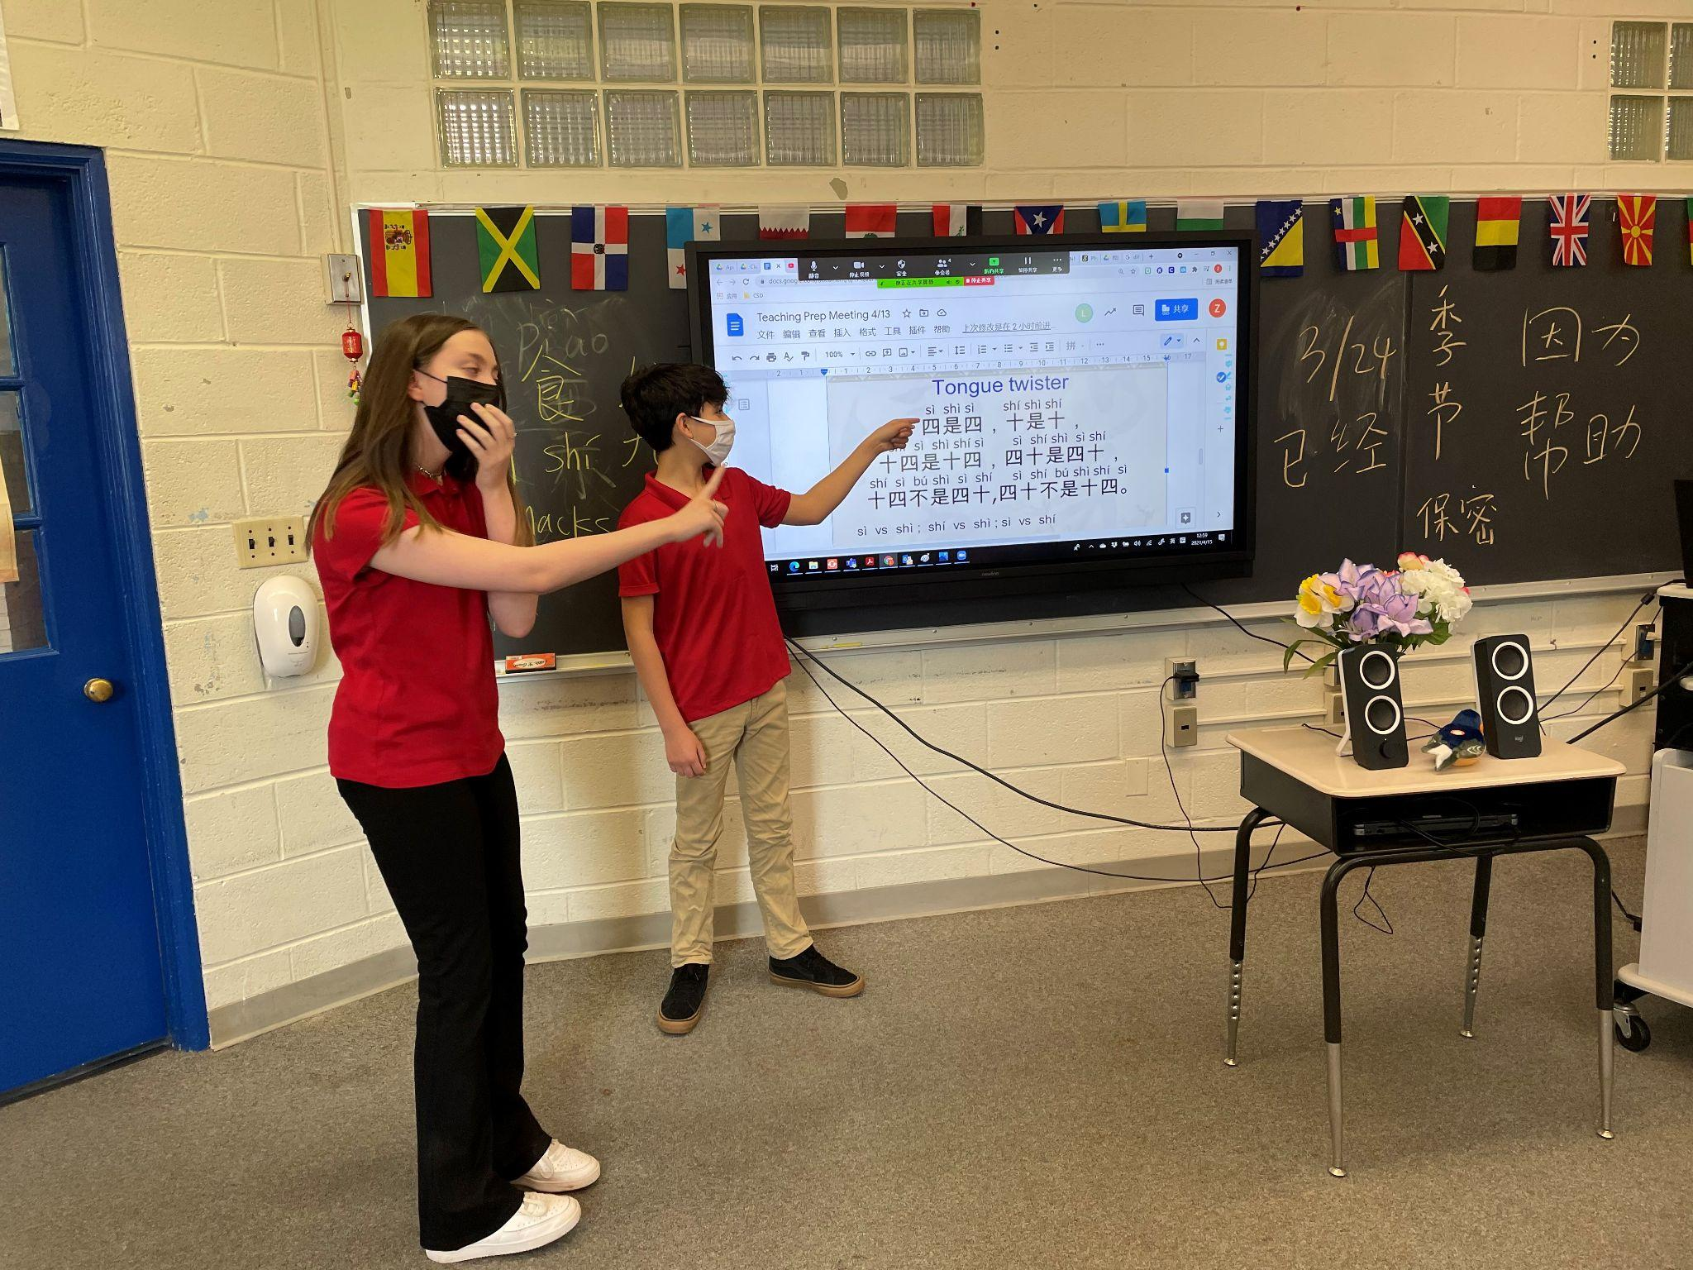
Global Village

Slide 31
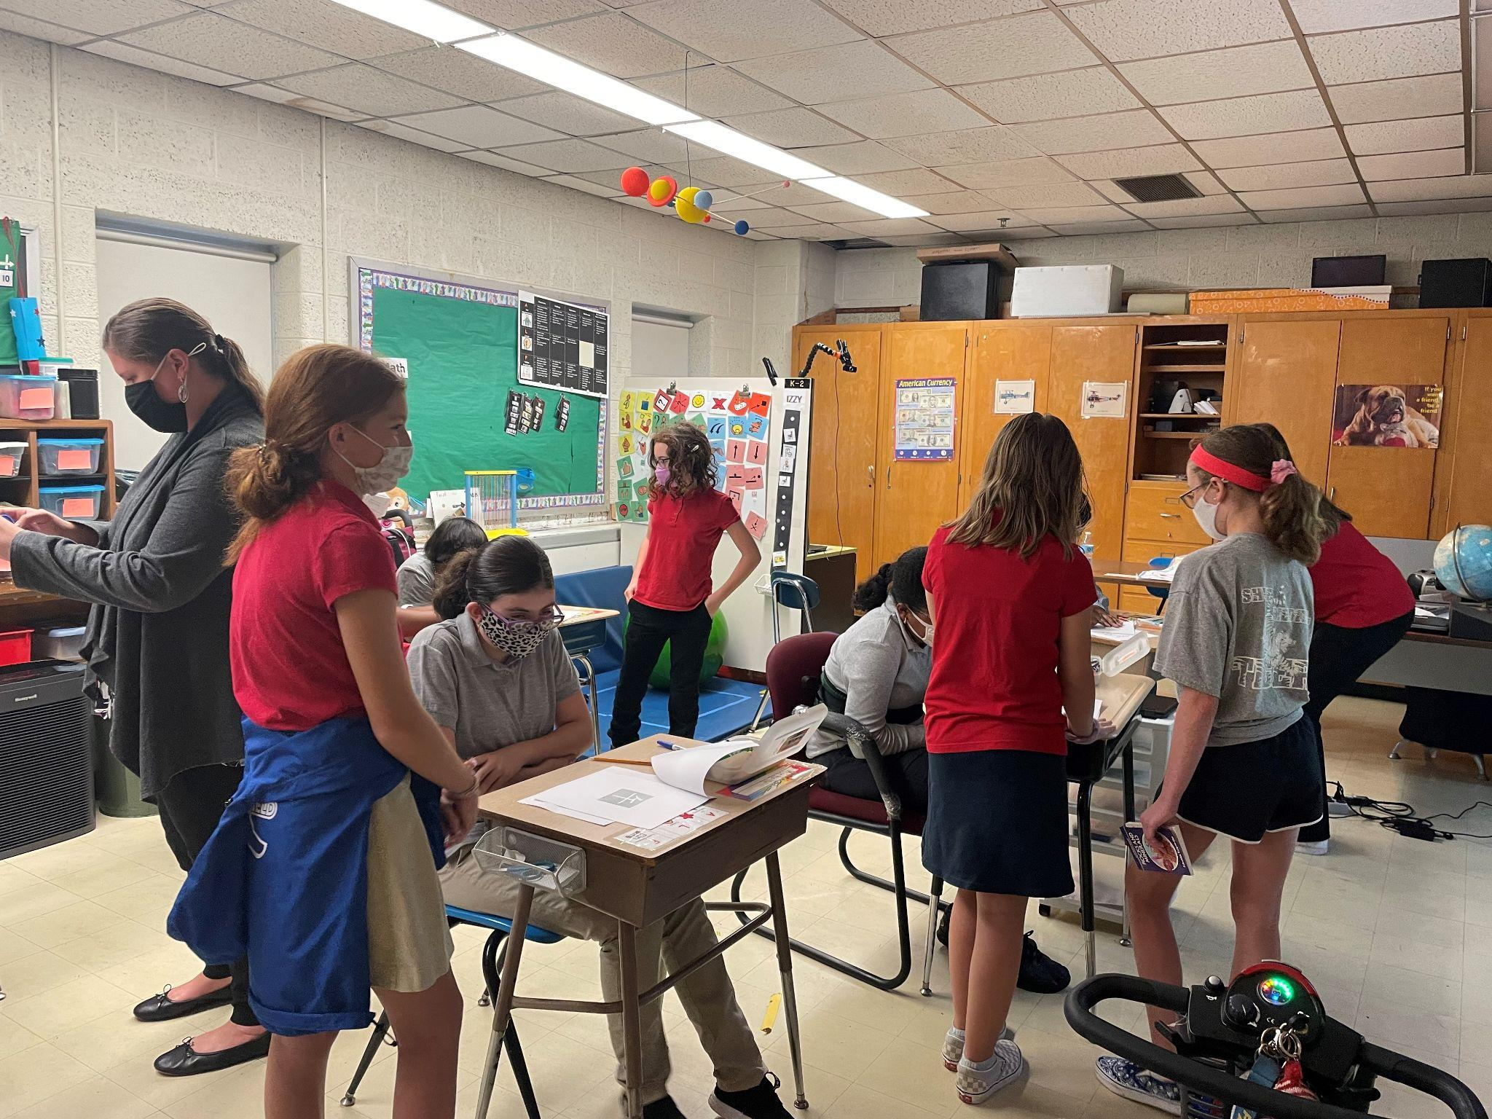
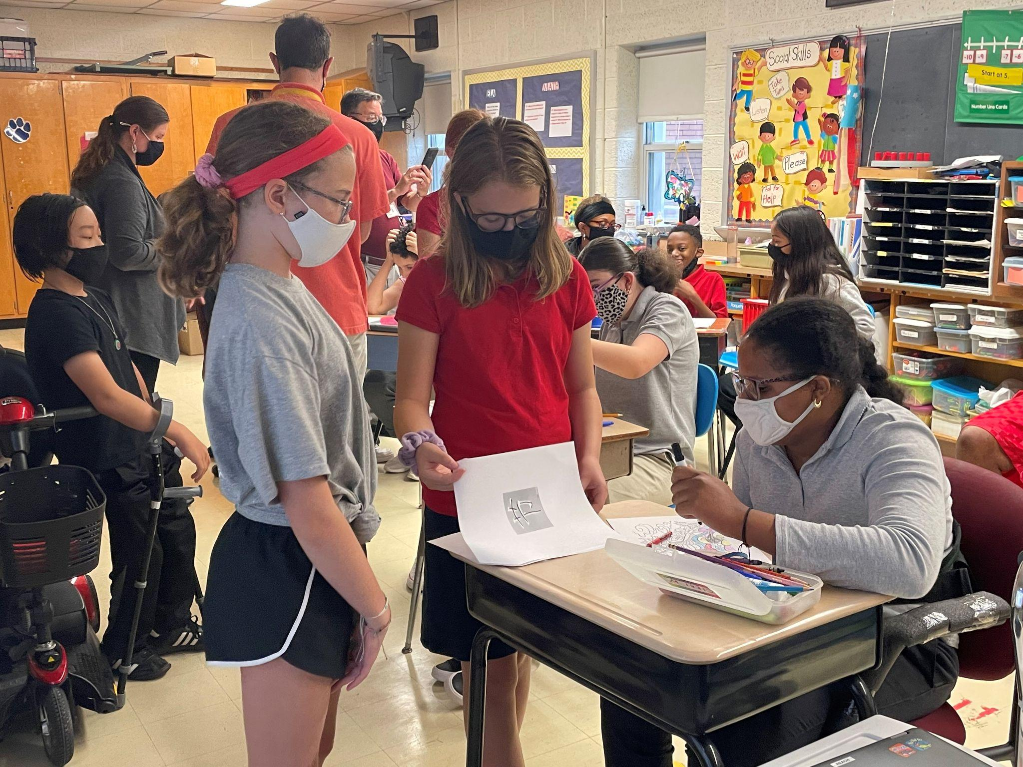
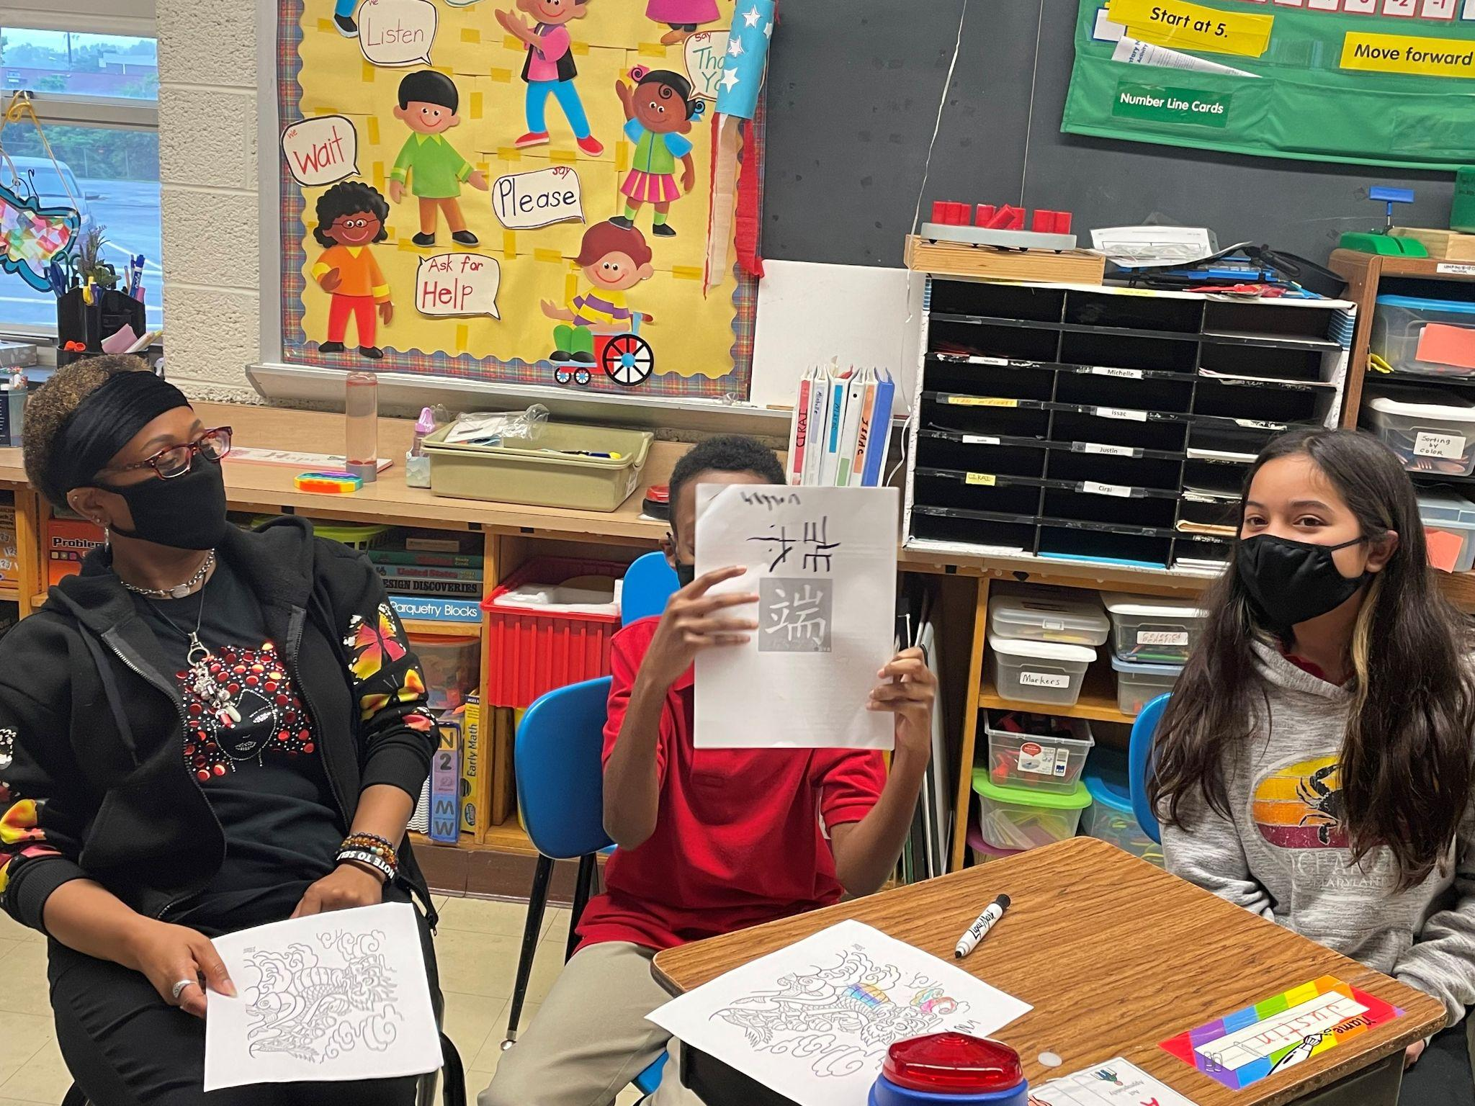
Visit REACH Students and Teach Them Chinese

Slide 32
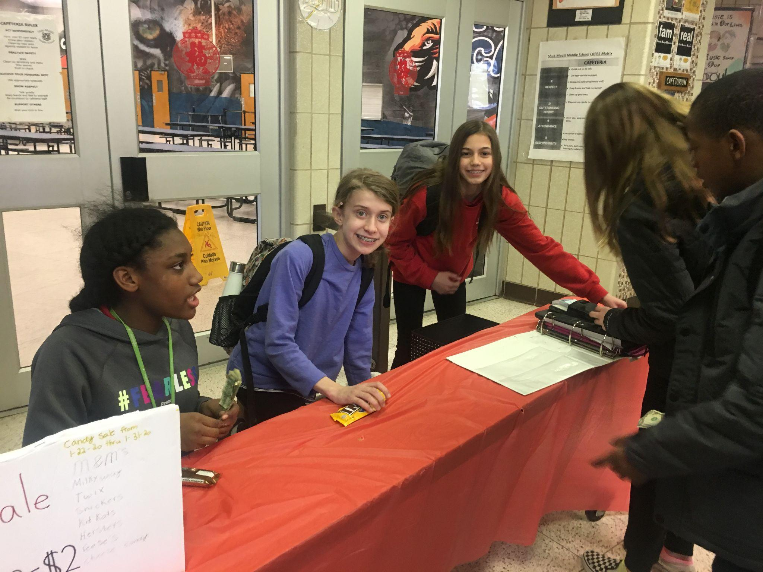
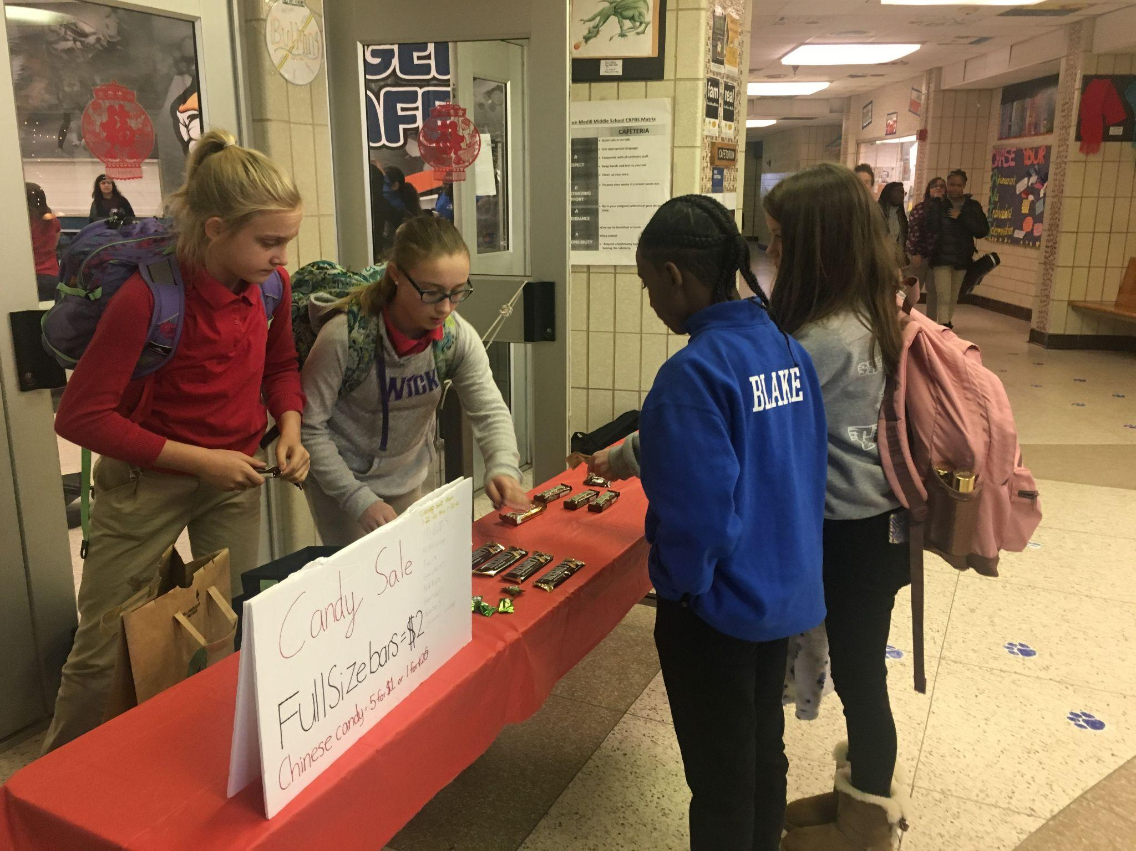
Candy Sale for Immersion Fund Raising:

Slide 33
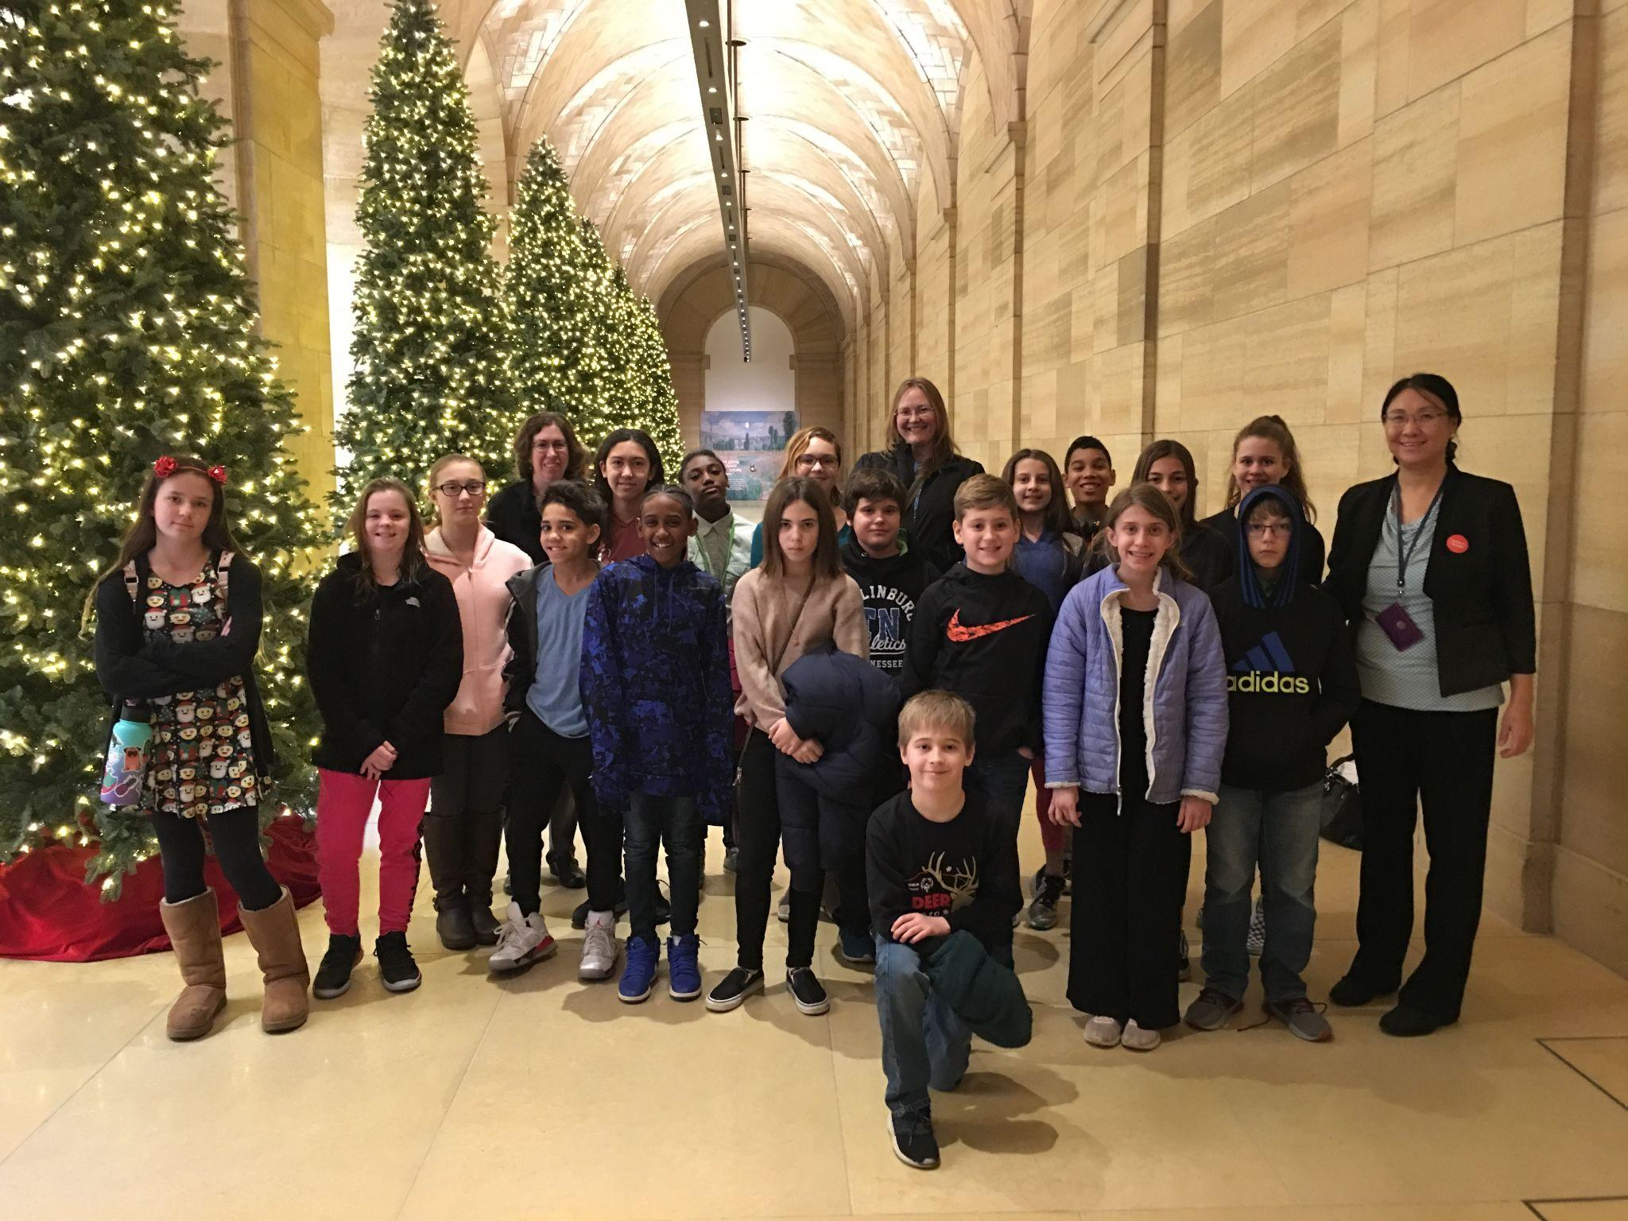
Field Trip to The Philadelphia Museum of Art

Slide 34
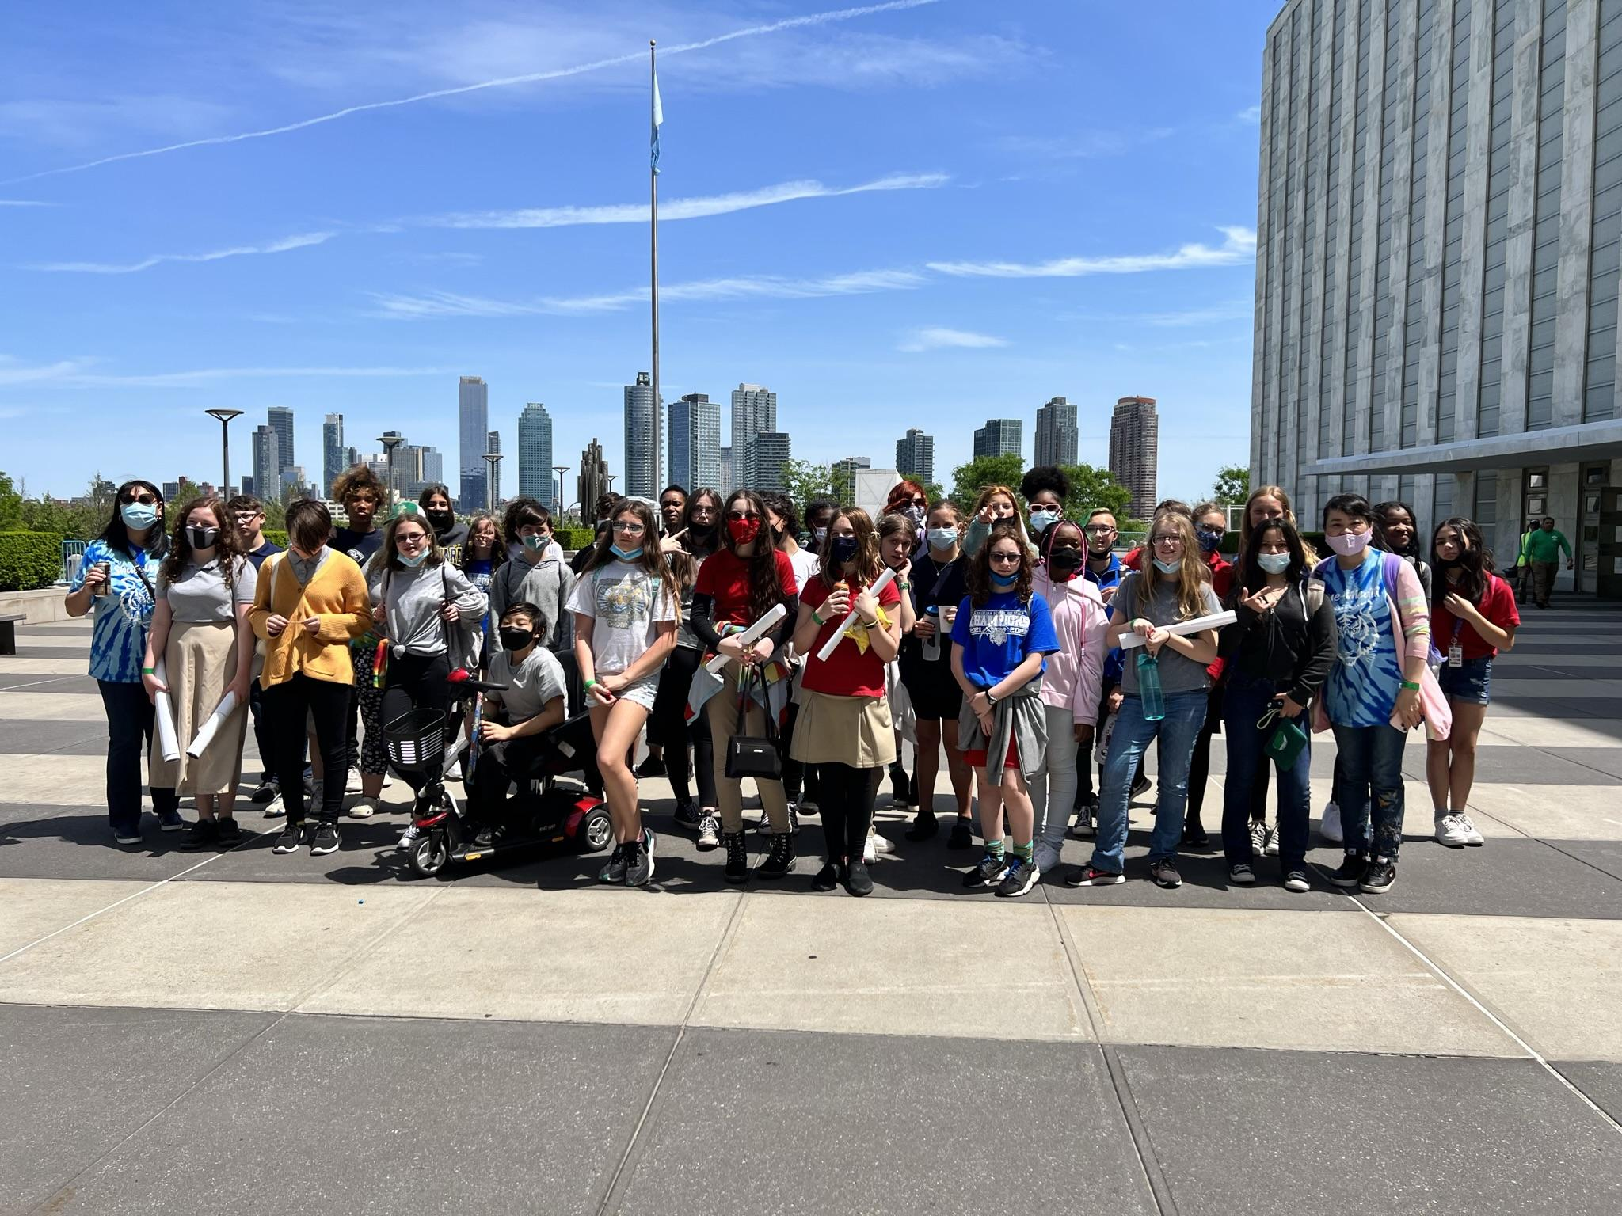
Field Trip to New York

